Slide 1
The Rationale for Testing
Why do we test? What are the underlying principles of testing?

Slide 2
Testing in the 21st Century
Software defines behavior
network routers, finance, switching networks, other infrastructure
Today’s software market :
is much bigger
is more competitive
has more users
Embedded Control Applications
airplanes, air traffic control
spaceships
phones
ovens
remote controls
Agile processes put increased pressure on testers
Programmers must unit test – with no training or education!
Tests are key to functional requirements – but who builds those tests ?
Industry is going through a revolution in what testing means to the success of software products
cars (Tesla autopilot)
smart watches
IoT devices (Nest thermostats)
home security

Slide 3
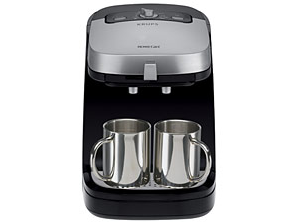

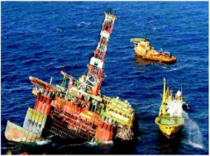
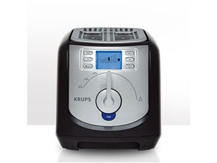

Software is a Skin that Surrounds Our Civilization
Quote by Dr. Mark Harman

Slide 4
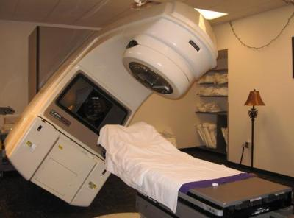
Therac-25 (1985-1987)
Therac-25: first dual treatment mode radiation therapy machine
Hardware-based safety measures replaced by software-based ones
Race condition:
UI reported safe levels of radiation to be delivered in error.
Actual delivery: 100x the expected dose
Bug was in previous code base, but was overridden by hardware controls
Resulted in at least 3 deaths, 3 debilitating injuries
Byte overflow:
Setup verification used a byte variable Class3: 0 ==okay, !0==adjustment needed
Each setup verification step: ++class3
256th verification roll over to zero
Resulted in at least one serious injury
Follow-up showed no test plan, no independent verification

Slide 5

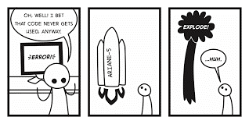
Ariane 5 (6/4/1996)
37 seconds into maiden flight flips 90 degrees, tears apart, self-destructs
Problem traced to:
The value of a 64-bit floating-point variable being stuffed into a 16-bit integer, and,
A value produced by the processor for debugging was mistaken for flight data.
Code from Ariane 4 was removed for perf
Result:
Loss of $370,000,000
Scientific study of magnetosphere delayed 4 years.

Slide 6


Mars Climate Orbiter (9/23/1999)
Experienced a “rapid unanticipated disassembly” on approach to Mars
Why?
Unanticipated impact of solar radiation put vehicle off intended trajectory
Imperial (Lockheed) v. metric (NASA) units used by ground control
Result:
Vehicle burned up in the Martian atmosphere
$235m lost
Loss of communications relay for the Mars Polar Lander
Sure, we’ll use newton-seconds!
Let’s use pound-seconds!

Slide 7

Northeast Blackout of 2003
508 generating units and 256 power plants shut down
Affected 10 million people in Ontario, Canada
Affected 40 million people in 8 US states
Financial losses of
$6 Billion USD
The alarm system in the energy management system failed due to a software error and operators were not informed of the power overload in the system

Slide 8

The Knight Capital Group debacle (8/1/2012)
Program trading nightmare: code installed on one server:
Includes an algorithm mistakenly buys at bid price and sells at ask price, thus losing a few cents on each transaction…
…as fast as it can.
What happened?
“Power Peg” was an algorithm to be used by QA to drive up stock price.
A switch to turn on Power Peg was erroneously repurposed. When deployed, the server thought it was in a test environment.
Power Peg was actually outdated code that should have been removed; safety checks had been inadvertently removed 7 years earlier.
The result: 4 million trades with a loss of $460,000,000.
No formal review process, no devops controls.

Slide 9
Other failures of note…
2011: California releases 450 violent felons from prison due to software error. Many felons still remain free.
2012: Apple Maps is released with missing towns, incorrect placed locations, obscured satellite imagery, etc.
2015: Starbucks “routine refresh” causes register malfunction forcing 60% of US and Canada stores to close.
2016: Nest thermostat firmware update leaves customers unable to hear their homes on one of the coldest weekends of the year
2017: AWS goes down for four hours. In 2016, when it went down for 20 minutes on a smaller number of sites, the outage cost Amazon $3.75m

Slide 10
Software Failures: Pervasive and Costly
NIST report, “The Economic Impacts of Inadequate Infrastructure for Software Testing” (2002)
Inadequate software testing costs the US alone between $22 and $59 billion annually
Better approaches could cut this amount in half
Huge losses due to web application failures
Financial services : $6.5 million per hour (just in USA!)
Credit card sales applications : $2.4 million per hour (in USA)
People expect software to be dependable.
Proper testing is one way to assess dependability.

Slide 11
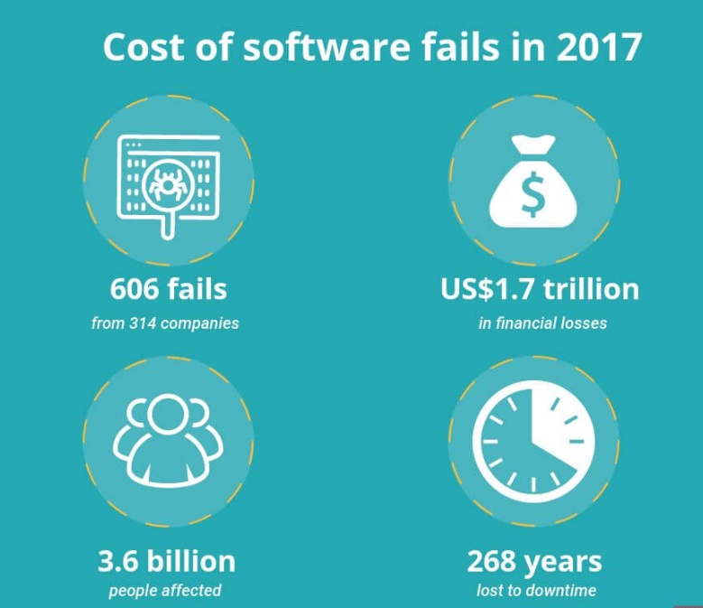
Updated (but maybe less reliable)
“Cost of Software Errors: How Much Could Software Errors Be Costing Your Company?” Raygun, Raygun, 22 Mar. 2017,

Slide 12
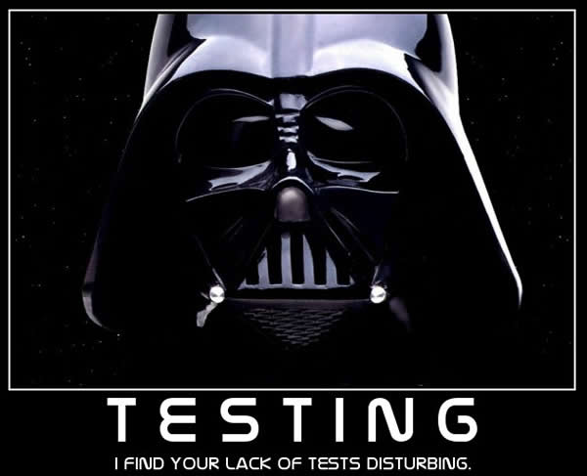

Slide 13
Modern Systems Require Modern Testing
More safety critical, real-time software
Embedded software is ubiquitous
Enterprise applications means bigger programs, more users
Security is now all about software faults
Secure software is reliable software
The web as a deployment platform adds a new wrinkle
Very competitive and very available to more users
Web apps are distributed
Web apps must be highly reliable
Testing tools and techniques must continue to evolve

Slide 14
What does this all mean?
Software testing is becoming
even more important
What are we trying to do when we test ?
What are our goals ?

Slide 15
Validation & Verification (IEEE-STD-610)
Validation: The process of evaluating software at the end of software development to ensure compliance with intended usage
Verification: The process of determining whether the products of a given phase of the software development process fulfill the requirements established during the previous phase
IV&V: “independent verification and validation”

Slide 16
Testing Goals Based on Test Process Maturity Derived from SEI Capability Maturity Model
Level 0: There’s no difference between testing and debugging
Level 1: The purpose of testing is to show correctness
Level 2: The purpose of testing is to show that the software doesn’t work
Level 3: The purpose of testing is not to prove anything specific, but to reduce the risk of using the software
Level 4: Testing is a mental discipline that helps all IT professionals develop higher quality software

Slide 17
Level 0 Thinking
Testing is the same as debugging
Does not distinguish between incorrect behavior and mistakes in the program
Does not help develop software that is reliable or safe

Slide 18
Level 1 Thinking
Purpose is to show correctness
…but “correctness” is impossible to determine
What do we know if no failures?
Good software or bad tests?
Test engineers have no:
Strict goal
Real stopping rule
Formal test technique
Test managers are powerless

Slide 19
Level 2 Thinking
Purpose is to show failures
Looking for failures is a negative activity
Puts testers and developers into an adversarial relationship
What if there are no failures?
This describes most software companies.

Slide 20
Level 3 Thinking
Testing can only show the presence of failures
Whenever we use software, we incur some risk
Risk may be small and consequences unimportant
Risk may be great and consequences catastrophic
Testers and developers cooperate to reduce risk
This describes a few “enlightened” software companies

Slide 21
Level 4 Thinking
A mental discipline that increases quality
Testing is only one way to increase quality
Test engineers can become technical leaders of the project
Primary responsibility to measure and improve software quality
Testers’ expertise should help developers
This is the way “traditional” engineering works

Slide 22
Tactical Goals : Why Each Test ?
Written test objectives and requirements must be documented.
What is each test trying to determine?
What are your planned coverage levels?
How much testing is enough – the definition of done for testing.
Old school – test until it’s time to ship

Slide 23
Why Each Test ?
If you don’t start planning for each test when the functional requirements are formed, you’ll never know why you’re conducting the test
What are the threshold reliability requirements?
What fact does each test try to verify?
Requirements definition teams should include testers

Slide 24
Bottom Line: Testing is Expensive...
But not testing is even more expensive
Testing is the most time consuming and expensive part of software development
Inadequate testing can lead to tremendous losses
If we have too little testing effort early, the cost of testing increases
Planning for testing after development is prohibitively expensive

Slide 25
The ISTQB Error Taxonomy
Error: A human action that produces an incorrect result. Syn: mistake
Defect: An imperfection or deficiency in a work product where it does not meet its requirements or specifications. Syn: fault, bug
Failure: An event in which a component or system does not perform a required function within specified limits. Syn: unexpected result, crash, system go “boom”
There are similar anomaly taxonomies offered by IEEE and ISO, but we’ll use these ISTQB definitions.

Slide 26
Defects in software are equivalent to design mistakes in hardware.
Software does not degrade.

Slide 27
A Concrete Example
Fault: Should start searching at 0, not 1
public static int CountZero (int[] array)
{
//If array is null, throw NullPointerException,
//else return the number of occurrences of 0 in array
int count = 0;
for(int i = 1; i < array.Length; i++)
{
if(array[i] == 0)
{
count++;
}
}
return count;
}
Test 1
[ 2, 7, 0 ]
Expected: 1
Actual: 1
Result of the fault: i is 1, not 0, on the first iteration
Failure: none
Test 2
[ 0, 2, 7 ]
Expected: 1
Actual: 0
Result of the fault: i is 1, not 0
i propagates to the variable count
Failure: count is 0 at the return statement

Slide 28


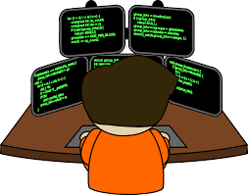
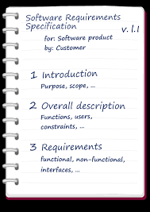
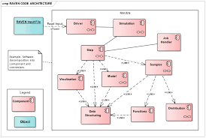
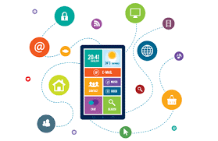
How defects are introduced
Designer
Analyst
Developer
Requirements
Specification
App Design
Software

Slide 29



How defects are introduced
Designer
Analyst
Developer
Defect
Defect
Defect
Requirements
Specification
App Design
Software

Slide 30
Finding defects late is expensive
Cost to repair
Notes:
28-Oct-2010, at GTAC, added the animation to demonstrate increasing the number of faults found early, thereby decreasing the number of faults found late, and finally saving money. Lots of it! This animation is fairly complicated … must practice first!!

Slide 31
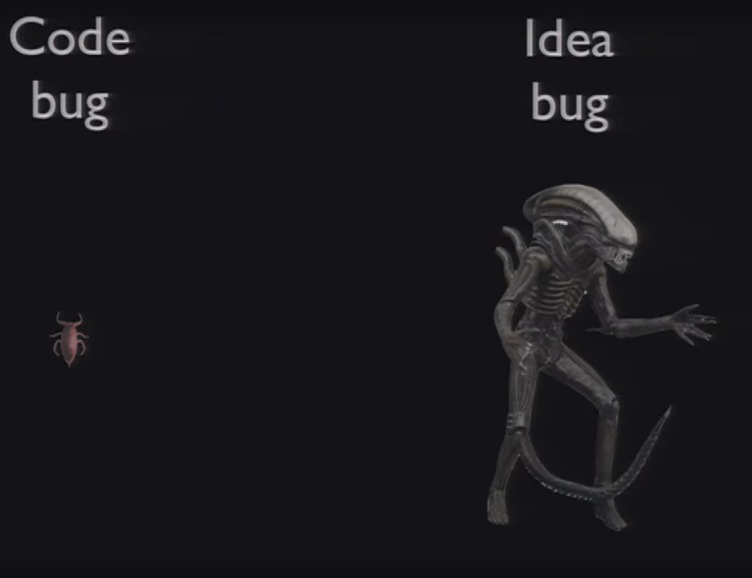

GTAC 2011: Opening Keynote Address - Test is Dead presented by Albert Savoia

Slide 32
Aside: Defects in a test basis v. executing code
Test basis: the documents from which the requirements of a system can be inferred, e.g.:
Use cases and user stories
UX designs
Functional specs
Design docs
Test bases can have defects that impact implementation in the form of:
Inaccuracies
Ambiguities
Omissions
Inconsistencies
Contradictions
Superfluous statements

Slide 33
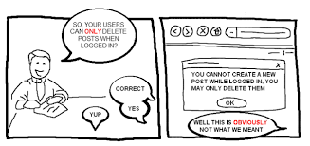
Ambiguity woes

Slide 34
How testing affects quality
Testing can reduce the risk of failure
Testing can be applied throughout the life cycle
Correcting defects increases quality and lowers risk (of course)
System quality can be inferred from test-related metrics:
Frequency of defect discovery
Number of discovered defects
Extent of test coverage
Percentage of tests passing
These data can be used to improve processes to avoid defect introduction in future.

Slide 35
Testing as Defined by ISTQB
The process consisting of all lifecycle activities, both static and dynamic, concerned with planning, preparation and evaluation of software products and related work products to determine that they satisfy specified requirements, to demonstrate that they are fit for purpose and to detect defects.

Slide 36
Thus, Testing is More than Test Execution
Test
Planning
Report results
Design
Tests
Test Execution
Verify user needs are met
Implement
Tests
Assess
Overall Quality
. . .

Slide 37
Core Software Testing Roles
Tester : An IT professional who is in charge of one or more technical test activities
Designing test inputs
Producing test values
Running test scripts
Analyzing results
Reporting results to developers and managers
Test Manager : In charge of one or more test engineers
Sets test policies and processes
Interacts with other managers on the project
Otherwise supports the engineers
Software companies often distinguish between:
Software Test Engineers (STEs)
Software Development Engineers in Test (SDETs)
Microsoft terms

Slide 38
Software Testing Roles
Test management : Sets policy, organizes team, interfaces with development, chooses criteria, decides how much automation is needed, …
Test maintenance : Save tests for reuse as software evolves
Requires cooperation of test designers and automators
Deciding when to trim the test suite is partly policy and partly technical – and in general, very hard !
Tests should be put in configuration control
Test documentation : All parties participate
Each test must document “why” – criterion and test requirement satisfied or a rationale for human-designed tests
Ensure traceability throughout the process
Keep documentation in the automated tests

Slide 39
Complexity of Testing Software
No other engineering field builds products as complicated as software
The term correctness has no meaning
Is a building correct?
Is a car correct?
Is a subway system correct?
Like other engineers, testers must use abstraction to manage complexity
This is the purpose of the model-driven test design process
The “model” is an abstract structure

Slide 40
At the Core of the Test Discipline: Testing and Debugging
Testing : Evaluating software by observing its execution
Test Failure : Execution of a test that results in a software failure
Debugging : The process of finding a fault given a failure
Not all inputs will “trigger” a fault into causing a failure

Slide 41
Fault (defect) & Failure Model (RIPR)*
Four conditions necessary for a failure to be observed
Reachability : The location or locations in the program that contain the fault must be reached
Infection : The state of the program must be incorrect
Propagation : The infected state must cause some output or final state of the program to be incorrect
Reveal : The tester must observe part of the incorrect portion of the program state
Coined by the Ammann and Offutt. It’s not in general use but is still effective.

Slide 42

RIPR Model
Reachability
Infection
Propagation
Revealability
Test
Final Program State
Reaches
Incorrect Final State
Observed Final Program State
Defect
Infects
Propagates
Incorrect Program State
Reveals
Test Oracle
Tester
Notes:
The failures can be revealed when the observed final program state has overlap with the incorrect final program state.
The question is: should testers check the entire program state? How to observe the incorrect program state in a cost-effective manner.
Getting the overlap as big as possible and the cost as small as possible.

Slide 43
Static and Dynamic Testing
Static testing is the testing of a work product without code being executed, e.g.,
Evaluate user stories
Inspection of design
Automated or manual code inspection
Dynamic testing is testing that involves the execution of the software of a component or system, e.g.,
Unit testing
UI-focused test tools (browser automation, for instance)
System regression tests

Slide 44
Seven Testing Principles see ISTQB Certified Tester Foundation Level Syllabus Version 2018, pp 16-17
Testing shows presence of defects, not their absence
Exhaustive testing is impossible
Early testing saves time and money
Defects cluster together
Beware of the pesticide paradox
Testing is context dependent
Absence-of-errors is a fallacy

Slide 45
The Test Process is Contextual see ISTQB Certified Tester Foundation Level Syllabus Version 2018, pp 16-17
Development lifecycle model/methodologies?
Business domain?
Level of acceptable product and project risk?
Operational constraints (money, time, complexity, contracts, regulations)?
Internal/external standards?

Slide 46
Test Activities per ISTQB
Test planning – What are we doing here?
Test monitoring and control – How are we doing now?
Test analysis - What should we be testing based on the project state?
Test design – How should we test?
Test implementation – Building test environment, procedures, suites
Test execution – Run ‘em
Test completion – Lessons learned, report results, onward and upward

Slide 47
Test Traceability
Each test activity has associated test work products
Each work product should be associated with its test basis

Slide 48
The Tester’s Mindset
Curiosity
Professional pessimism
A critical eye
Attention to detail
Experience
Good communication skills
Successful developers think differently than successful testers.

Slide 49


Psychology of Testing: Different Mindsets
Hi! I’m a tester! I’m here to help!
Developer
Tester
I need to get this routine done! Stay out of my way!
Wait! This software is complex.
I need to figure out what might go wrong!
I know what I’m doing! Get off my back!
There are defects in your code and I’m going to find ‘em, you hack!
Gahhhh!
Gahhhh!
This Photo by Unknown Author is licensed under CC BY

Slide 50
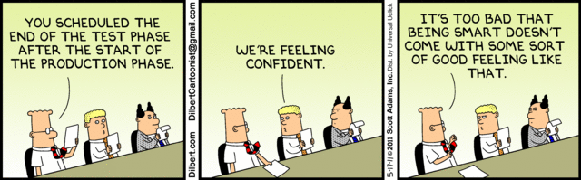
The truth of it: We need testers
Unit testing by a developer tops out at 40 – 50% defect detection effectiveness
Independent test teams score 85% - 98%.

Slide 51
The Rationale for Testing Software
A tester’s goal is to eliminate faults as early as possible
Improve quality
Reduce cost
Maximize customer satisfaction

Slide 52
Reality check
As a point of fact, testers are increasingly being folded into development organizations. The lines are becoming blurred.
“Fail fast” is a popular philosophy. I.e., minimal testing, publish the software, fix it rapidly when problems are found.
The more critical the software, though, the more important formal testing becomes.
Bug in a game? No biggie.
Data loss at a CC company? Biggie.
Online hotel reservations? Not such a big deal.
Passenger airplane avionics? Big, big deal.

Slide 53
ISIT 324 Software Testing
2020.01.15
Chapter 2, et al

Slide 54
First things first...
In case you have Monday classes, next Monday is a holiday
I’ll be traveling Thursday through Monday. Email responses may be slower than usual and grading may take longer than usual.
I mentioned that I’d check to see whether VS Enterprise (as opposed to Community) is required. It turns out that several VS features we will be using require VS. These include:
Live Unit Testing
Code Coverage
Microsoft Fakes

Slide 55
On the Docket
Complete last week’s lecture: Rationale and Foundation
Homework 1 review
In-class discussion 1
This week’s lecture: Testing Throughout the Life Cycle

Slide 56
The Rationale for Testing - The Stirring Conclusion
Why do we test? What are the underlying principles of testing?

Slide 57
Software Testing Activities
Tester : An IT professional who is in charge of one or more technical test activities
Designing test inputs
Producing test values
Running test scripts
Analyzing results
Reporting results to developers and managers
Test Manager : In charge of one or more test engineers
Sets test policies and processes
Interacts with other managers on the project
Otherwise supports the engineers
Software companies often distinguish between:
Software Test Engineers (STEs)
Software Development Engineers in Test (SDETs)
Microsoft terms

Slide 58
Other Activities
Test management : Sets policy, organizes team, interfaces with development, chooses criteria, decides how much automation is needed, …
Test maintenance : Save tests for reuse as software evolves
Requires cooperation of test designers and automators
Deciding when to trim the test suite is partly policy and partly technical – and in general, very hard !
Tests should be put in configuration control
Test documentation : All parties participate
Each test must document “why” – criterion and test requirement satisfied or a rationale for human-designed tests
Ensure traceability throughout the process
Keep documentation in the automated tests

Slide 59
Complexity of Testing Software
No other engineering field builds products as complicated as software
The term correctness has no meaning
Is a building correct?
Is a car correct?
Is a subway system correct?
Like other engineers, we must use abstraction to manage complexity
This is the purpose of the model-driven test design process
The “model” is an abstract structure

Slide 60
At the Core of the Test Discipline: Testing and Debugging
Testing : Evaluating software by observing its execution
Test Failure : Execution of a test that results in a software failure
Debugging : The process of finding a fault given a failure
Not all inputs will “trigger” a fault into causing a failure

Slide 61
Fault (defect) & Failure Model (RIPR)*
Four conditions necessary for a failure to be observed
Reachability : The location or locations in the program that contain the fault must be reached
Infection : The state of the program must be incorrect
Propagation : The infected state must cause some output or final state of the program to be incorrect
Reveal : The tester must observe part of the incorrect portion of the program state
Coined by the Ammann and Offutt. It’s not in general use but is still effective.

Slide 62
RIPR Model
Reachability
Infection
Propagation
Revealability
Test
Final Program State
Reaches
Incorrect Final State
Observed Final Program State
Defect
Infects
Propagates
Incorrect Program State
Reveals
Test Oracle
Tester
Notes:
The failures can be revealed when the observed final program state has overlap with the incorrect final program state.
The question is: should testers check the entire program state? How to observe the incorrect program state in a cost-effective manner.
Getting the overlap as big as possible and the cost as small as possible.
Note: a test oracle is a mechanism for determining whether a test has passed or failed.

Slide 63
Static and Dynamic Testing
Static testing is the testing of a work product without code being executed, e.g.,
Evaluate user stories
Inspection of design
Automated or manual code inspection
Dynamic testing is testing that involves the execution of the software of a component or system, e.g.,
Unit testing
UI-focused test tools (browser automation, for instance)
System regression tests

Slide 64
Seven Testing Principles see ISTQB Certified Tester Foundation Level Syllabus Version 2018, pp 16-17
Testing shows presence of defects, not their absence
Exhaustive testing is impossible
Early testing saves time and money
Defects cluster together
Beware of the pesticide paradox
Testing is context dependent
Absence-of-errors is a fallacy

Slide 65
The Test Process is Contextual see ISTQB Certified Tester Foundation Level Syllabus Version 2018, pp 16-17
Development lifecycle model/methodologies?
Business domain?
Level of acceptable product and project risk?
Operational constraints (money, time, complexity, contracts, regulations)?
Internal/external standards?

Slide 66
Test Activities per ISTQB
Test planning – What are we doing here?
Test monitoring and control – How are we doing now?
Test analysis - What should we be testing based on the project state?
Test design – How should we test?
Test implementation – Building test environment, procedures, suites
Test execution – Run ‘em
Test completion – Lessons learned, report results, onward and upward

Slide 67
Test Traceability
Each test activity has associated test work products
Each work product should be associated with its test basis

Slide 68
The Tester’s Mindset
Curiosity
Professional pessimism
A critical eye
Attention to detail
Experience
Good communication skills
Successful developers think differently than successful testers.

Slide 69
Psychology of Testing: Different Mindsets
Hi! I’m a tester! I’m here to help!
Developer
Tester
I need to get this routine done! Stay out of my way!
Wait! This software is complex.
I need to figure out what might go wrong!
I know what I’m doing! Get off my back!
There are defects in your code and I’m going to find ‘em, you hack!
Gahhhh!
Gahhhh!
This Photo by Unknown Author is licensed under CC BY

Slide 70
The truth of it: We need testers
Unit testing by a developer tops out at 40 – 50% defect detection effectiveness
Independent test teams score 85% - 98%.

Slide 71
The Rationale for Testing Software
A tester’s goal is to eliminate faults as early as possible
Improve quality
Reduce cost
Maximize customer satisfaction

Slide 72
About Q3: Remember this? Validation & Verification (IEEE-STD-610)
Validation: The process of evaluating software at the end of software development to ensure compliance with intended usage
Verification: The process of determining whether the products of a given phase of the software development process fulfill the requirements established during the previous phase

Slide 73
Validation requires an understanding of what the program needs to do
Given this function:
…how can you be sure it’s doing what it’s supposed to?
public static var CalcSqrt(var number)
To properly test you need to understand precisely what is intended
Notes:
To do validation:
Can the input include decimals?
What to do when a non-numeric is provided?
Is return a floating point?
How many significant digits to return, particularly for irrational numbers?
Negative numbers: what to return (imaginary numbers)?
To do verification:
Does the program behave as specified?

Slide 74
Testing Throughout the Lifecycle
Notes:
Note that Ammann and Offutt are very much computer science-focused with a strong emphasis on math. While this bias permeates the book, we’ll take the relevant parts and omit the rest.

Slide 75
Software Testing Activities
Tester : An IT professional who is in charge of one or more technical test activities
Designing test inputs
Producing test values
Running test scripts
Analyzing results
Reporting results to developers and managers
Test Manager : In charge of one or more test engineers
Sets test policies and processes
Interacts with other managers on the project
Otherwise supports the engineers
Software companies often distinguish between:
Software Test Engineers (STEs)
Software Development Engineers in Test (SDETs)
Microsoft terms

Slide 76
How defects are introduced
Designer
Analyst
Developer
Requirements
Specification
App Design
Software

Slide 77
How defects are introduced
Designer
Analyst
Developer
Defect
Defect
Defect
Requirements
Specification
App Design
Software

Slide 78
Finding defects late is expensive
Cost to repair
Notes:
28-Oct-2010, at GTAC, added the animation to demonstrate increasing the number of faults found early, thereby decreasing the number of faults found late, and finally saving money. Lots of it! This animation is fairly complicated … must practice first!!

Slide 79
Software Life Cycle and Testing
For every development activity there is a corresponding test activity
Each test level has test objectives specific to that level
Test analysis and design for a given test level begins during the corresponding development activity
Testers participate in refinement of requirements and design, review work products when available

Slide 80
Software Testing Levels
Acceptance testing : Is the software acceptable to the user?
main Class P
System testing : Test the overall functionality of the system
Class A
Class B
Integration testing : Test how modules interact with each other
method mA1()
method mB1()
method mA2()
method mB2()
Component testing:
Module testing (developer testing) : Test each class, file, module, component
Unit testing (developer testing) : Test each unit (method) individually

Slide 81
SDLC Models
Sequential
Waterfall: Development activities completed in sequence, testing comes last.
V-Model: Like the waterfall, but testing is integrated with development activities
Iterative/Incremental
Specification grows incrementally
Agile
Software features grow incrementally
Testing is planned and executed for each deliverable
Testing is planned and executed in each increment
Testers are an integral part of each Agile team
Additional detail added in each iteration

Slide 82
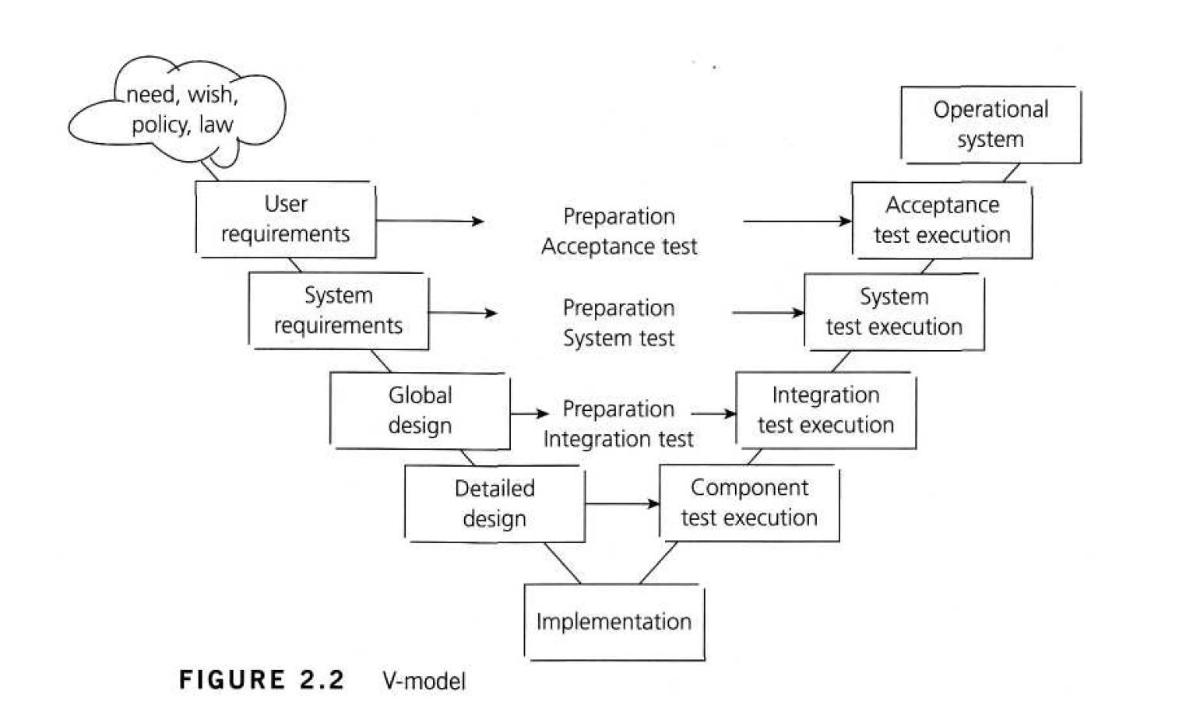
Cost of Late Testing
60
50
40
30
Fault origin (%)
Fault detection (%)
Unit cost (X)
20
10
This correspondence goes beyond the waterfall-style V-Model.
0
Requirements
Design
Prog / Unit Test
Integration Test
System Test
Post-Deployment
Includes unit testing

Slide 83
Component Testing
Objectives
Reduce risk  Verify behaviors  Build confidence in component quality  Find defects  Contain defects
Test basis
Detailed design
Code
Data structures
Component specs
Test objects
Components
Code and data structures
Classes
DB modules
Typical defects and failures
Functionality doesn’t match design spec
Issues with data “flow” between modules
Incorrect logic
Specific Approaches
Test-driven development
Behavior-driven development
Mostly developer-driven

Slide 84
Integration Testing
Objectives
Reduce risk  Verify behaviors  Build confidence in interfaces  Find defects  Contain defects
Test basis
Overall design
Sequence diagrams
Interface/comms protocol specs
Use cases
Test objects
Subsystems
Databases
Infrastructure
APIs
Microservices
Architecture
Workflows
External Interface definitions
Typical defects and failures
Interface mismatches
Incorrect data encoding
Comms failures between components
Incorrect assumptions
Specific Approaches
Component integration: developers
Integration testing: testers

Slide 85
System Testing
Objectives
Reduce risk  Verify behaviors  Build confidence in system as a whole  Find defects  Contain defects
Test basis
System/Reqmts specs
Risk analyses
Epics/User stories
Use cases
Test objects
Applications
HW/SW systems
Operating systems
System under test
System configuration
Conceptual models
State diagrams
Manuals
Typical defects and failures
Incorrect/unexpected behaviors
Failure to complete end-to-end tasks
Production environment shortcomings
Failure to operate as described in manuals
Specific Approaches
Techniques used are context-driven
Best performed by independent testers

Slide 86
Acceptance Testing
Objectives
Build confidence in system as a whole  Validate against expectations  Validate against specs
Test basis
Bus processes
User requirements
Regs and standards
Contracts
Use cases
Test objects
Software (SUT)
Configurations
Business processes
Recovery systems
Operational/maintenance processes
Converted data
System requirements
Documentation
Ops procedures
Install procedures
DR procedures
Typical defects and failures
Workflows fail to meet requirements
Business rules incorrect
Contractual / Regulatory requirements not met
Non-functional failures: security, perf, etc.
Specific Approaches
UAT: Conducted by users
OAT: Conducted by ops
Contractual/Regulatory: Users/Independent testers
Alpha and Beta testing

Slide 87
Test Types
Functional
Non-functional
Structural
Change-related

Slide 88
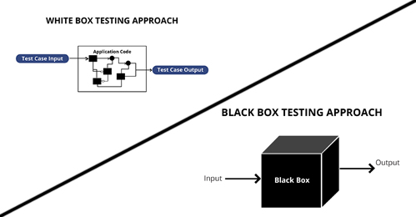
Aside: Colored Boxes
Procedure to derive and/or select test cases based on an analysis of the specification, either functional or non-functional, of a component or system without reference to its internal structure.
Procedure to derive and/or select test cases based on an analysis of the internal structure of a component or system
…and then there’s “gray box” twixt the twain

Slide 89
Functional testing
Does the system do what it’s supposed to do?
All work products can be evaluated to ensure they represent that they meet the application needs.
Thoroughness of testing via coverage
Involves subject matter experts at each level.
Black box techniques are used when testing software.

Slide 90
Non-functional testing
How well does the system do what it’s supposed to?
Usability
Performance/Stress
Security
Non-functional elements should be evaluated at each test level as early as possible
Special knowledge of underlying tech is almost always required
Black box techniques are used here, too.

Slide 91
Structural Testing
Structural testing looks at the static internals of artifacts
Also known as white-box testing
Focused on software elements, not so much on upstream specs
Equivalence partitioning
Boundary analysis
Coverage

Slide 92
Change-Related Testing
Obviously, testing when a change is made for some reason.
Two facets:
Confirmation testing: did the change work?
Regression testing: did anything else accidentally break?

Slide 93
Homework 2 Overview

Slide 94
ISIT 324 Software Testing
Testing Frameworks (1)

Slide 95
On the Docket
Homework 2 Review
Discussion 2
Test Automation using MSTest

Slide 96
Test Automation
Notes:
Note that Ammann and Offutt are very much computer science-focused with a strong emphasis on math. While this bias permeates the book, we’ll take the relevant parts and omit the rest.

Slide 97
What is Test Automation?
The use of software to control the execution of tests, the comparison of actual outcomes to predicted outcomes, the setting up of test preconditions, and other test control and test reporting functions
Reduces cost
Reduces human error
Reduces variance in test quality from different individuals
Significantly reduces the cost of regression testing
Regression testing is the process of testing code that has been modified

Slide 98
Software Testability
The degree to which a system or component facilitates the establishment of test criteria and the performance of tests to determine whether those criteria have been met
Plainly speaking – how hard it is to find faults in the software (remember RIPR)
Testability is dominated by two practical problems
How to provide the test values to the software
How to observe the results of test execution

Slide 99
Observability and Controllability
Observability
Software that affects hardware devices, databases, or remote files have low observability
Controllability
Easy to control software with inputs from keyboards
Inputs from hardware sensors or distributed software (including Web applications)is harder
Data abstraction reduces controllability and observability
How easy it is to observe the behavior of a program in terms of its outputs, effects on the environment and other hardware and software components?
How easy it is to provide a program with the needed inputs, in terms of values, operations, and behaviors?

Slide 100
Components of a Test Case
A test case is a multipart artifact with a definite structure
Test case values
Expected results
A test oracle uses expected results to decide whether a test passed or failed
The input values needed to complete an execution of the software under test
The result that will be produced by the test if the software behaves as expected

Slide 101
FindLast Refresher

Slide 102
Test Automation Framework
A set of assumptions, concepts, and tools that support test automation
Popular frameworks for .Net
MSTest v2 (built into VS 2017)
NUnit
xUnit
Comparison: http://xunit.github.io/docs/comparisons.html
Note: this doc shows MSTest v1.5. MSTest v2 is better.
Current consensus:
MSTest is better integrated into VS than the others (although the others are still pretty nicely integrated), but
xUnit is the next stage in unit testing evolution and is most full-bodied
JUnit for Java aficionados

Slide 103
MSTest, xUnit, NUnit, JUnit, et al, can be used to test:
An entire object,
A part of an object – a method or some interacting methods, or
Interaction between objects
Good for unit and integration testing, but not so much for system testing

Slide 104
Components of the Testing Environment
Software Under Test (SUT)
Test Class
Test Runner

Slide 105
MSTest Special Sauce
MSTest v2 pre-integrated into VS starting in 2017
Create a UnitTest project and you get:
References to the Testing assemblies
A shell that includes unit test .Net attributes, and
A handy using statement for the UnitTesting namespace
[TestClass] tells VS that the following class holds unit tests
[TestMethod] tells VS that the following method is a unit test
Assert is a method that the Test Runner can use to determine whether a method passed or failed.

Slide 106
Arrange, Act, Assert
General convention for constructing a test (using TDD, discussed in an upcoming lecture)
Arrange: Get everything ready to call the method. Initialize classes, variables, etc.
Act: Call the method.
Assert: Check to see whether the method returned the expected result

Slide 107
Method Naming Conventions
FindLast test where:
x = {1, 2, 5}, and
y = 1
Lots of Alternatives
FindLastTest1
TestReturnIndexOfFirstElement
FindLast_LastInstanceIsFirstElement_ReturnsZero
FindLast_Should ReturnZero_WhenLastInstanceIsFirstElement

Slide 108
In this class:
Put all tests of a method in the same class named <method>_Should
Each test is a TestMethod and is named <expected behavior>_When<state being tested>
Examples:
TestClass public class FahrenheitToCelsius_Should
TestMethod ReturnZero_WhenInputIs32
TestMethod Return100_WhenInputIs212
TestMethod ThrowException_WhenInputIsMinus1000

Slide 109
Make FindLast Tests Proper Unit Tests

Slide 110
Unit Test initial setup
Add a Unit Test project to the solution
Right click the solution name
Select Add -> New Project
In the left nav bar, select Test
Select Unit Test Project (.NET Framework)
For grins, look at the References in the Unit Test project
Note: that reference to System is what allows you to use the programs in the System namespace

Slide 111
Unit Test initial setup (continued)
Add NuGet packages to supply assemblies to support Unit Testing and the Test Explorer (no longer usually required)
Right-click the Unit Test project you added
Select Manage NuGet packages
Select the Browse tab.
Search for MSTest
Select MSTest.TestFramework and select Install, accept the license, etc.
Select MSTest.TestAdapter and select Install, accept the license, etc.
Now look at references again. See the new stuff?

Slide 112
Unit Test initial setup (continued)
Add a reference from the Unit Test project to the project under test
Solution Explorer: Right-click References in the Unit Test project
Select Add Reference to start the Reference Manager
Choose Projects -> Solution in the Reference Manager navigation window
Select your ClassLibrary project and click OK.
Look at the references in Solution Explorer and you’ll see the reference added.
Add a using statement to alias the Class Library namespace to the name SUT (for Software Under Test).

Slide 113
Useful patterns…
Make it easy to identify software under test:
Check to see if an exception is properly thrown:
Class name and method name are readable:
Organize your tests using Arrange, Act, Assert
using SUT = FindLast30.SearchArray;
Assert.ThrowsException<NullReferenceException>(() => SUT.FindLast(x, y));
public class FindLast_Should
public void ReturnMinus1_ForSearchValueNotInArray()

Slide 114
The Tests (based on Manual Test Harness)
FindLast_Should…
ReturnNegative1_WhenInputNotInArray
Return1_WhenInputInSecondPosition
Return0_WhenInputInFirstPosition
ThrowNullReferenceException_WhenArrayIsNull

Slide 115
Consolidate Common Tests Using Parameterization
New in MSTest v2
Fibonacci

Slide 116
Parameterized Tests
Provides a way to iteratively inject expected and actual values into the same test method. Test runs repeatedly until value sets are exhausted.
MSTest V2, NUnit and xUnit all support parameterization of tests.
NUnit and xUnit use the terms “Fact” to describe non-parameterized tests and “Theory” for parameterized ones.
MSTest uses “DataTestMethod.” Doesn’t sound quite as grand, but it’s about the same thing.

Slide 117
Parameterizing in MSTestV2
[DataTestMethod] attribute identifies parameterized test method
[DataRow(values)] attributes for each test execution
Values: comma-separated list of values to be fed to the test method parameters
By convention, the last value is the “expected” value
Test method
One parameter per list of values in DataRow attributes
Executes once per data row
Each time substitutes one set of DataRow values for parameters

Slide 118
ISIT 324 Software Testing
Test-Driven Development

Slide 119
First things first
Midterm will be held the week after next
Timed exam with penalties for going over time.
Held in class on 2/12, although you may take it online
Will be open until 2/12 at 1159pm
Covers everything through Test-Driven Development (this week’s and next’s topic)
Note: was going to be next week but I want time for you to absorb homework comments.

Slide 120
On the Docket
A note about C# coding
About error, defect and failure…
Homework 3 Review
Lecture: Test-Driven Development
About Homework 4

Slide 121
A note on C# coding
Any time you’re coding in a specific language, you should do your best to follow its conventions. Unlike Java, in C#:
Main() comes before other methods
Method names are PascalCase rather than camelCase.
Class names are PascalCase, instantiated variable names are camelCase.
Everyone got the braces right. It’s actually difficult to do it wrong in VS.

Slide 122
About error, defect and failure
The ISTQB Error Taxonomy
Error: A human action that produces an incorrect result. Syn: mistake
Defect: An imperfection or deficiency in a work product where it does not meet its requirements or specifications. Syn: fault, bug
Failure: An event in which a component or system does not perform a required function within specified limits. Syn: unexpected result, crash, system go “boom”

Slide 123
From ISTQB Syllabus section 1.2.3
A person can make an error (mistake), which can lead to the introduction of a defect (fault or bug) in the software code or in some other related work product. If a defect in the code is executed, this may cause a failure, but not necessarily in all circumstances. For example, some defects require very specific inputs or preconditions to trigger a failure, which may occur rarely or never.

Slide 124
Homework 3 –Faults/Potential Faults
CalcPricePerAnvil: Bad range check (think back to “Accurate and Efficient Range Checking” in PROG 110). The value 10 is unaccounted for.
CalcPricePerAnvil: If regprice is less than zero, the discount price will be negative, which makes no sense.
CalcShippingCostPerAnvil: Zone is relative to one, but the array index is relative to zero.
Any others?

Slide 125
Homework 3 – Minimum set of tests
CalcPricePerAnvil_Should Return10Pct Discount_WhenQuantityIs10
CalcPricePerAnvil_Should Return0_WhenPriceIsNegative
CalcShippingCost_Should Return10Dollars_WhenZone1

Slide 126
In-Class Group Discussion 3: Testing Frameworks
10 Points
Add yourself to a group in the Discussion 3 group set
One student submits answers

Slide 127
Test-Driven Development

Slide 128
Unit Testing != Test-Driven Development
TDD == Write Unit Tests First

Slide 129
How? Why?
TDD is for Developers, not Testers
Rationale:
A developer has to understand the problem before they can write a test
Writing the test first tends to minimize developer bias
Exposes errors early
Solid unit tests support regression testing

Slide 130
TDD promotes optimal software development
TDD made simple
Write unit tests first (MSTest, NUnit, JUnit, xUnit, …)
Handle dependencies on external elements (MOQ, FakeItEasy, Mockito)*
Get a clue about completeness of tests using code coverage
Optimal because:
Test cases first: you’ll miss fewer
YAGNI**: You’re encouraged not to write extra code “just in case”
When using agile methods, software is deemed correct when it behaves correctly on a specific set of tests. TDD encourages creation of the right set of tests.
*Not covered in this module
**You ain’t gonna need it

Slide 131
The TDD Process: Red, Green, Refactor
RED
(fail)
GREEN
(pass)
REFACTOR
…and do it again
Write a correct test that fails…
Improve code quality…
Add code to enable test to pass…

Slide 132
American Football Yardage Calculator
Test-Driven Development Example

Slide 133
Two Methods
DistanceToGoalLine
Input
string end: starting end of field (OWN or OPP)
int startingYardLine
int yardageOnPlay: yardage gained (+) or lost (-) on play
Returns new distance from the goal line (int)
FieldGoalDistance
Input
string end: starting end of field (OWN or OPP)
int startingYardLine: line of scrimmage
Returns distance to end zone + 17 yards (int)

Slide 134
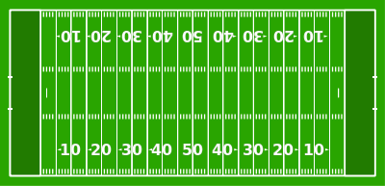

OWN end of the field
OPPONENT’S end of the field
90 Yards to goal
Gain 40
50 Yards to goal
Lose 27
77 Yards to goal
Assume team is moving in this direction
Farthest possible starting point from goal (-9…9 yards into OWN end zone)
Goal (OPPONENT’S end zone)

Slide 135
DistanceToGoalLine Rules
end must be OPP or OWN unless startingYardLine is 50, in which case end may be OPP, OWN or 50
startingYardLine can be a value between -9, OWN* and 1, OPP.
The raw distance to the goal minus yardageOnPlay may not be less than 0 or greater than 100
If the play goes beyond the OPP goal line, return zero (touchdown).
If the play goes behind OWN goal line, return 100 (safety)
Invalid values provided to the method yield an ArgumentException
Valid values that result in an invalid result yield an ApplicationException, including:
Returns distance to goal in yards (int)

Slide 136
OWN end of the field
OPPONENT’S end of the field
35 yards to goal post
42-yard FG
52 yards to post
69-yard FG
Farthest possible starting point from goal (-9…
Goal post is at the back of the end zone, ten yards from the goal line
Kicker stands ~ 7 feet behind line of scrimmage

Slide 137
FieldGoalDistance Rules
end must be OPP or OWN unless startingYardLine is 50, in which case end may be OPP, OWN or 50
Must start on a yard line between:
40 on OWN side
1 on OPP’s side
Invalid values provided to the method yield an ArgumentException
Returns distance of field goal == distance to goal + 17

Slide 138
FieldGoalDistance tests
end | lineOfScrimmage | Expected Result
OPP | 30 | 47 | 30+17
OPP | 50 | 67 | 50+17
OWN | 48 | 69 | 50 + (50 – 48) + 17 = 69
 | 50 | 67
OWN | 20 | 100 | 105, so return 100
OWN | -9 | 0 | Longest run possible!
 | 20 | ArgumentException | Missing end
OWN | 51 | ArgumentException | 51 is invalid
OWN | -10 | ArgumentException | -10 is invalid
OPP | -1 | ArgumentException | -1 is invalid for OPP
OWN | 39 | ApplicationException | Starts too far back

Slide 139
FieldGoalDistance tests
In this demo:
Live Unit Testing
Fluent Assertions
Notes:
TDD walkthrough OneNote

Slide 140
RED
(fail)
GREEN
(pass)
REFACTOR

Slide 141
FieldGoalDistance implementation

Slide 142
RED
(fail)
GREEN
(pass)
REFACTOR

Slide 143
FieldGoalDistance Refactor error handling

Slide 144
RED
(fail)
GREEN
(pass)
REFACTOR

Slide 145
DistanceToGoal tests
end | starting YardLine | yardageOn Play | Expected Result
OWN | 20 | 19 | 61 | 50 + (50 – 20) - 19 = 61
OPP | 20 | 19 | 1 | 20 – 19 = 1
OWN | 50 | 55 | 0 | -5, so return 0
 | 50 | 55 | 0 | -5, so return 0
OWN | 20 | -25 | 100 | 105, so return 100
OWN | -9 | 109 | 0 | Longest run possible!
 | 20 | 10 | ArgumentException | Missing end
OWN | 51 | 10 | ArgumentException | 51 is invalid
OWN | -10 | 10 | ArgumentException | -10 is invalid
OPP | -1 | 10 | ArgumentException | -1 is invalid for OPP
OPP | 1 | 11 | ApplicationException | Returns -10. Invalid.
OWN | 15 | 109 | ApplicationException | Returns 124. Invalid.

Slide 146
DistanceToGoal tests
Notes:
TDD walkthrough OneNote

Slide 147
RED
(fail)
GREEN
(pass)
REFACTOR

Slide 148
DistanceToGoal Implementation

Slide 149
RED
(fail)
GREEN
(pass)
REFACTOR

Slide 150
DistanceToGoal Refactor

Slide 151
RED
(fail)
GREEN
(pass)
REFACTOR

Slide 152
When to stop testing?
Test until fear turns to boredom.
…but code coverage helps, too.

Slide 153
Potpourri on TDD
TDD is not the answer for everything (multi-threading, security options, complex configs, UX, etc.)
TDD is just a part of this complete (testing) breakfast
What about private methods? Generally, test the public ones.
Tests should be able to run in any order; no dependencies

Slide 154
More to come with Test Doubles: Mocks, Fakes, Stubs, Shims
Object doesn’t exist
Behavior is indeterminate
Human interaction-dependent
Hard to set up
Mimic external resources (database, network, etc.)
General test isolation
We’ll experiment with these later

Slide 155
ISIT 324 Software Testing
2020.02.05
Fakes, Stubs, Shims, Mocks

Slide 156
First things first…
A new software disaster!
The big picture: Coding disasters have been with us as long as there's been software, and in the past they've led to exploding space missions and lethal doses of radiation for cancer patients. In this case, the failure of a new app, followed by long delays with a phone-reporting backup system, seems to have crippled the calendar-leading Iowa Democratic caucuses — adding a fresh element of instability to our troubled election system.
- Axios, 2/4/2020: Software disaster sinks Iowa caucus

Slide 157
On the Docket
About the midterm
HW3 Post Mortem comments + HW4 one-day amnesty
HW4 review
Closing remarks on TDD
Test Doubles: Principles
Shims ride-along (maybe…)
Stubs ride-along
Mock object (via Moq) ride-along
In-Class Discussion?

Slide 158
Midterm Notes
In-Class test next Wednesday, 2/12
Complete test in class for full credit
Turn in after class ends, receive 15% deduction
Covers everything through Test-Driven Development
Use whatever resources you want except for live humans (in class or online!)
No submissions will be accepted after 2/12 at 11:59pm.
Format of test:
12 questions.
8 through 12 include a coding problem and require you to build a unit test

Slide 159
Coding tips for the Midterm
Remember the remainder (%) operator?
How to specify an array in a [DataRow]?
What does “executing a defect” mean?
Note: There is an example helper file on the Test Doubles module page you might find useful!

Slide 160
Accurate and Efficient Range Checking
Main lesson applicable to all languages: when checking ranges, don’t test the same boundary in two conditions
Two versions: nested-ifs and array-based
Hint: in the nested-if version, you know something is amiss when:
You use an AND or an OR in your condition, or
You have inequality operators going in different directions (< and >=, for instance.)
Example: Range checking

Slide 161
Errors not to be repeated
Use .NET Framework, not .NET Core for all your projects! After HW3, you’ll receive a deduction if you do not.
Write your tests to pass! Some students wrote tests where the expectation was that a test would fail.
If your code doesn’t compile, you’ll receive a zero on the coding portion
Use the formulation I specified for test class and method naming…

Slide 162
From the Testing Frameworks lecture In this class I want you to use this convention:
Put all tests of a method in the same class named <method>_Should
Each test is a TestMethod and is named <expected behavior>_When<state being tested>
Examples:
TestClass public class FahrenheitToCelsius_Should
TestMethod ReturnZero_WhenInputIs32
TestMethod Return100_WhenInputIs212
TestMethod ThrowException_WhenInputIsMinus1000

Slide 163
HW4 One-Day Amnesty
If you have already turned in HW4, and
If you have any of the issues on the “Errors not to be repeated” slides,
Then you may correct the errors and turn in your homework again tonight with no additional penalty.

Slide 164
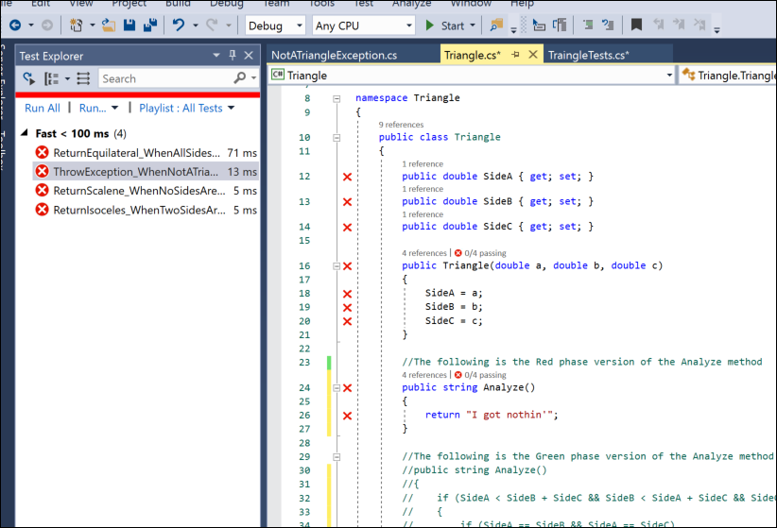
Homework 4 Review Notes

Slide 165
TDD Summary and Wrap-Up

Slide 166
How? Why?
TDD is for Developers, not Testers
Rationale:
A developer has to understand the problem before they can write a test
Writing the test first tends to minimize developer bias
Exposes errors early
Solid unit tests support regression testing

Slide 167
TDD promotes optimal software development
TDD made simple
Write unit tests first (MSTest, NUnit, JUnit, xUnit, …)
Handle dependencies on external elements (MOQ, FakeItEasy, Mockito)*
Get a clue about completeness of tests using code coverage
Optimal because:
Test cases first: you’ll miss fewer
YAGNI**: You’re encouraged not to write extra code “just in case”
When using agile methods, software is deemed correct when it behaves correctly on a specific set of tests. TDD encourages creation of the right set of tests.
*Covered later in the course
**You ain’t gonna need it

Slide 168
The TDD Process: Red, Green, Refactor
RED
(fail)
GREEN
(pass)
REFACTOR
…and do it again
Write a correct test that fails…
Improve code quality…
Add code to enable test to pass…

Slide 169
When to stop testing?
Test until fear turns to boredom.*
How long is a piece of string?
…but code coverage helps, too.
*Kent Beck

Slide 170
Potpourri on TDD
TDD is not the answer for everything (multi-threading, security options, complex configs, UX, etc.)
TDD is just a part of this complete (testing) breakfast
What about private methods? Generally, test through public ones.
Tests should be able to run in any order; no dependencies

Slide 171
Test Doubles
Simulating dependencies on external elements

Slide 172
Test Doubles: Mocks, Fakes, Stubs, Shims
Object doesn’t exist
Behavior is indeterminate
Human interaction-dependent
Hard to set up
Mimic external resources (database, network, etc.)
General test isolation

Slide 173
Tenuous Definitions
Double = a replacement for a production module in testing
Fake = a simple replacement for some component
Shim = a fake that doubles for a system component
Stub = a simple fake that doubles for a custom component
Mock = a complex double that dynamically mimics the behavior of the item being mocked
Can be generated by hand or generated by using a fake or mocking framework.
Here are some alternative taxonomies.

Slide 174
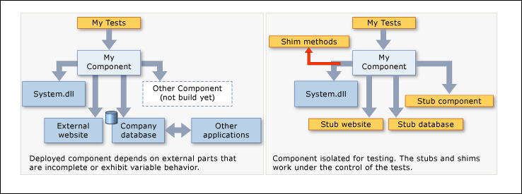
Shims and Stubs

Slide 175
Ride-Alongs using Microsoft Fakes
Shim ride-along: Fake out system date
Stub ride-along: Fake out a component somebody else is building (in our case, a file system)

Slide 176
Date Checker: using a shim
Class:
public static class SpecialDateChecker
Methods:
public static string CheckNewYear()
returns MSG_HAPPY_NEW_YEAR if today is New Year’s Day
returns MSG_BORED if today isn’t New Year’s Day
public static string CheckTuesday()
returns MSG_TUESDAY if today is Tuesday
returns MSG_SAD if today isn’t Tuesday

Slide 177
Shim Ride-Along (TDD)
Create Unit Test project
Under the Unit Test References, right-click on System and select “Add Fakes Assembly”. Wait for System.4.0.0.0.Fakes to appear.
Add the tests using a TDD approach.

Slide 178
Shim Ride-Along
Start with FakesShimStart solution.
Add new Unit Test project
Add reference to SUT project
Under the Unit Test References, right-click on System and select “Add Fakes Assembly”. Wait for System.4.0.0.0.Fakes to appear.
Add these using statements:
using System.Fakes;
using Microsoft.QualityTools.Testing.Fakes;
Now add the tests

Slide 179
Secret DateTime Shim Sauce
using (ShimsContext.Create())
{
ShimDateTime.NowGet = () => new DateTime(2000, 1, 1);
. . .
}

Slide 180
Shims don’t show? Solution:
After adding Fakes Assembly to System assembly (in the test project):
Replace the data in mscorlib.fakes with the XML on the right →
Delete System.4.0.0.0.Fakes reference
Delete System.fakes file
If there's an mscorlib.4.0.0.0.Fakes, delete it, too
Add Fakes Assembly to System again. There may be some error messages, but after a while (maybe > 1 minute) you'll see the assemblies pop up in References. Then you can build.
<Fakes xmlns="http://schemas.microsoft.com/fakes/2011/" Diagnostic="false">
<Assembly Name="mscorlib" Version="4.0.0.0" />
<StubGeneration>
<Clear />
</StubGeneration>
<ShimGeneration>
<Clear />
<Add FullName="System.DateTime!" />
</ShimGeneration>
</Fakes>
Per https://stackoverflow.com/questions/40039081/shimdatetime-not-available-in-system-fakes

Slide 181
Shims and Stubs

Slide 182
The keys to stubs
Your code under test must not explicitly mention classes in another application. You must use interfaces.
In other words, if you’re not using interfaces, you can’t use stubs.
Then, for every interface in the referenced assembly, Microsoft Fakes generates a “stub” class.
You direct your tests to substitute calls to the real class with those in the stub class.

Slide 183
Stubbing out FileSystem.ReadAllText
Use starting point: FakesStubFileSystemStart
Note that the starting point includes a Console App so you can watch the class run without a stub…but you’ll have to supply a file name at the appropriate point in the code (indicated by a comment).
The situation:
We’re building part of a new file system (using the old file system methods.)
Software under test: a method that tests whether a file is empty
We want to use a stub for FileSystem.ReadAllText so we don’t actually need to read and open a file. Capeesh?
We’ll add two tests that use the stub:
One to make sure IsEmpty returns true if the file is empty.
One to make sure IsEmpty returns false if the file has content

Slide 184
Creating a stub
Steps:
Create your SUT class file
Create an interface for the component you want to stub out and a class that implements it
Add a UnitTest project and add a reference to the SUT project
In the Unit Test project, right-click the reference to the SUT project and select “Add Fakes Assembly.”
Now you’ll have a stub version of the interface from 2, above, generated on your behalf. In your test, you can use it to pass data into your SUT. If the interface name is IFooBar, the generated stub is named StubIFooBar

Slide 185
Secret Stub Sauce
var fileSystem = new StubIFileSystem()
{
ReadAllTextString = filename => { return (content); }
};
This code sets up the stub.
StubIFileSystem is a class automatically generates by Fakes to enable you to redirect calls to members of IFileSystem.
ReadAllTextString is a generated method in that class. It is named by taking the original method name (ReadAllText) and appending its return type (String).
This stub is set up so that when the test calls ReadAllText, instead of actually reading text from anywhere it just returns the value from content.
When ReadAllText is called

Slide 186
Mock example using MOQ
Planned: Build a method to query a database and return a list of musical acts for a given genre
Actual: The database guys are running behind. We need to build mock objects to simulate responses from the DB.
MoqExampleStart has the starting point: no tests.
MoqExample includes the tests.
To add tests you must install Moq in the Unit Test project through NuGet

Slide 187
ISIT 324 Software Testing
2020.02.18
Doubles again…plus ISTQB Test Tool categories

Slide 188
On the Docket
Midterm Review
Stubs Homework
Finish up UnitTesting / Doubles with some ride-alongs:
MSFakes: Stubs (but we did that in the video)
MSFakes: Shims for System.dlls (because they got messed up last time)
MSFakes: Shims for custom assemblies
Moq Framework: using mock objects
Overview of ISTQB Test Tool categories

Slide 189
Test Doubles: Mocks and Other Fakes (Again)
My preference:
Can be generated by hand or generated by using a fake or mocking framework.
MSTest does shims and stubs, but not mocks or spies
Here are some alternative taxonomies.

Slide 190
My Doubles Taxonomy (incorporates MSFT definitions of shims)
Fake = anything identified in the book as a “Test Double” (p.12.2).
Shim = a fake that doubles for an assembly (a system component or a custom assembly)
Stub = a simple fake that doubles for a custom component
Mock = a complex fake that dynamically mimics the behavior of the item being mocked – or a stub
Spy = records information about how it is called or (less frequently) fakes out methods on a real object (as opposed to a mock one)

Slide 191
Fowler’s Doubles taxonomy
Dummy objects are passed around but never actually used. Usually they are just used to fill parameter lists.
Fake objects actually have working implementations, but usually take some shortcut which makes them not suitable for production (an in memory database is a good example).
Stubs provide canned answers to calls made during the test, usually not responding at all to anything outside what's programmed in for the test.
Spies are stubs that also record some information based on how they were called. One form of this might be an email service that records how many messages it was sent.
Mocks are what we are talking about here*: objects pre-programmed with expectations which form a specification of the calls they are expected to receive.
https://stackoverflow.com/questions/12827580/mocking-vs-spying-in-mocking-frameworks and
*https://martinfowler.com/articles/mocksArentStubs.html

Slide 192
Doubles ride-alongs
Shim ride-along (System assembly): DateTime
Stub ride-along (Step-by-step example): NewFileSystem (1)
Shim ride-along (Custom assembly): NewFileSystem (2)
MOQ mocking framework ride-along: ListOfBands
(Similar Video walkthrough)

Slide 193
Shim Ride-Along (System Assembly)
Example: CompletedDateTimes Shims demo
Start with Starting .cs file for ShimDateTime demo solution.
Create a class library, add source from SpecialDataChecker.cs (the above-mentioned file) into its Class.cs file.
Add new Unit Test project
Add reference to SUT project
Under the Unit Test References, right-click on System and select “Add Fakes Assembly”. Wait for System.4.0.0.0.Fakes to appear.*
Add these using statements:
using System.Fakes;
using Microsoft.QualityTools.Testing.Fakes;
Now add the test!
*If it never appears and you end up with errors in the Error List, look at the two Shims don’t show? solutions in a couple of slides.

Slide 194
Shim Ride-Along (System Assembly) - Secret Sauce
using (ShimsContext.Create())
{
//Arrange
ShimDateTime.NowGet = () => new DateTime(2000, 1, 1);
//Act
. . .
//Assert
. . .
}

Slide 195
Shims don’t show? Solution 1:
After adding Fakes Assembly to System assembly (in the test project), go to the generated Fakes folder and:
Replace the data in mscorlib.fakes with this XML →
Replace the data in System.fakes with this XML →
Then wait patiently to see the errors disappear (there may be warnings, but there should be no errors.)
<Fakes xmlns="http://schemas.microsoft.com/fakes/2011/">
<Assembly Name="mscorlib" Version="4.0.0.0"/>
<StubGeneration>
<Remove TypeName="X509Certificate"/>
</StubGeneration>
</Fakes>
<Fakes xmlns="http://schemas.microsoft.com/fakes/2011/" Diagnostic="true">
<Assembly Name="System" Version="4.0.0.0"/>
<StubGeneration>
<Remove TypeName="X509Certificate2"/>
</StubGeneration>
<ShimGeneration>
<Remove TypeName="X509Certificate2"/>
</ShimGeneration>
</Fakes>
Per https://stackoverflow.com/questions/40039081/shimdatetime-not-available-in-system-fakes

Slide 196
Shims don’t show? Solution 2:
After adding Fakes Assembly to System assembly (in the test project):
Replace the data in mscorlib.fakes with the XML on the right →
Delete System.4.0.0.0.Fakes reference
Delete System.fakes file
If there's an mscorlib.4.0.0.0.Fakes, delete it, too
Add Fakes Assembly to System again. There may be some error messages, but after a while (maybe > 1 minute) you'll see the assemblies pop up in References. Then you can build.
<Fakes xmlns="http://schemas.microsoft.com/fakes/2011/" Diagnostic="false">
<Assembly Name="mscorlib" Version="4.0.0.0" />
<StubGeneration>
<Clear />
</StubGeneration>
<ShimGeneration>
<Clear />
<Add FullName="System.DateTime!" />
</ShimGeneration>
</Fakes>
Per https://stackoverflow.com/questions/40039081/shimdatetime-not-available-in-system-fakes

Slide 197
The keys to stubs
Your code under test must not explicitly mention classes in another application. You must use interfaces.
In other words, if you’re not using interfaces, you can’t use stubs.
Then, for every interface in the referenced assembly, Microsoft Fakes generates a “stub” class.
You direct your tests to substitute calls to the real class with those in the stub class.

Slide 198
Stubbing out FileSystem.ReadAllText
Example: Completed Fake Stub File System from Video
Use starting point: Fake Stub File System Video Start
Note that the starting point includes a Console App so you can watch the class run without a stub…but you’ll have to supply a file name at the appropriate point in the code (indicated by a comment).
The situation:
We’re building part of a new file system (using the old file system methods.)
Software under test: a method that tests whether a file is empty
We want to use a stub for FileSystem.ReadAllText so we don’t actually need to read and open a file. Capeesh?
We’ll add two tests that use the stub:
One to make sure IsEmpty returns true if the file is empty.
One to make sure IsEmpty returns false if the file has content

Slide 199
Creating a stub
Steps:
Create your SUT class file
Create an interface for the component you want to stub out and a class that implements it
Add a UnitTest project and add a reference to the SUT project
In the Unit Test project, right-click the reference to the SUT project and select “Add Fakes Assembly.”
Now you’ll have a stub version of the interface from 2, above, generated on your behalf. In your test, you can use it to pass data into your SUT. If the interface name is IFooBar, the generated stub is named StubIFooBar

Slide 200
Secret Stub Sauce
var fileSystem = new StubIFileSystem()
{
ReadAllTextString = filename => { return (content); }
};
This code sets up the stub.
StubIFileSystem is a class automatically generates by Fakes to enable you to redirect calls to members of IFileSystem.
ReadAllTextString is a generated property in that class. It is named by taking the original method name (ReadAllText) and appending its parameter types (in this case, String).
This stub is set up so that when the test calls ReadAllText, instead of actually reading text from a file it simply returns the value from the ReadAllTextString property, which is, in turn, returned from content.

Slide 201
MS Fakes Shim Ride-Along 2 (SimulatedFileSystem)
In the Stub example, we had the source for the interface definition for INewFileSystem and NewReadAllText available.
What if we didn’t? What if all we had access to was an assembly that include:
The definition of the Interface, and
An implementation (including an implementation of the NewReadAllText method)?
This is a job for a Shim! It’s held in two projects:
Example is in FakeShimFileSystemEmptinessChecker
Assembly generated from FakeShimFileSystem

Slide 202
Creating and using a Shim for a custom assembly
Create your SUT class file that includes a call to the assembly to be shimmed.
In this case we’ll go to FakeShimFileSystem and find the .dll in the project folder under Debug
Add a UnitTest project and
Add a reference to the SUT class, and
Add a reference to the assembly to be shimmed
In the Unit Test project, right-click the reference to the assembly to be shimmed and select “Add Fakes Assembly.”
Now you’ll have a shim version of the classes in the fakes assembly. In your test, you can use them in place of the original classes. If the class in the assembly is FooBar, the shimmed version is ShimFooBar.
Add using statements for the Fakes assembly, the Fakes tools and the SUT project into your test project.

Slide 203
Shim Ride-Along (Custom Assembly)
using (ShimsContext.Create())
{
ShimClass.MethodToSub = () => (returnValue);
. . .
}
Or for instance methods...
using (ShimsContext.Create())
{
ShimClass.AllInstances.MethodToSub = () => (returnValue);
. . .
}

Slide 204
MOQ Framework Ride-Along (Music Acts)
Example: Completed Mock Music Acts
The scenario:
You’re testing a method that will access a database to return a list of bands by Genre.
Interaction with the database at the business layer is via an object collection.
Sadly, the database doesn’t exist yet.
BUT…we can mockup the object collection using the MOQ framework!
We’ll mock the interface IRepositoryOfMusicActs to create a MOQ mock for the entire kit and kaboodle.
Then we’ll test FindByGenre on the MusicActController class.

Slide 205
Using MOQ
Note that MOQ uses Interfaces just as Microsoft Fakes Stubs do
Create your SUT class file
Create an interface and a class that implements it
Add a UnitTest project and add a reference to the SUT class
Use NuGet to get Moq added to the UnitTest project
Add using statements for Moq and the SUT project into your test project
Use Mock<interface> to instantiate the mock object
Use .setup on the mock object to set delegates
When you pass the object into a class, use object.Object.

Slide 206
Mocks and Stubs in TDD
Mocking frameworks are used to create stubs or mocks
Two complementary approaches: Classic and Mockist
Classical
State-based (did I get the right values?)
Sometimes called the Detroit school (or sometimes Chicago)
Mockist
Behavior-based (did everything get called properly?)
Sometimes called the London school
Which is best? Horses for courses.
References:
http://dreat.info/2017/03/12/chicago-vs-london-tdd/
https://softwareengineering.stackexchange.com/questions/123627/what-are-the-london-and-chicago-schools-of-tdd
https://martinfowler.com/articles/mocksArentStubs.html
https://8thlight.com/blog/georgina-mcfadyen/2016/06/27/inside-out-tdd-vs-outside-in.html

Slide 207
Bonus: Fluent Assertions
Instead of this: Assert.AreEqual(0, result.Count);
…use this: result.Count.Should().Be(0);
Using NuGet, add Fluent Assertions to your test project
There may be other cruft you have to add (e.g., System.XML). You’ll be able to figure it out.

Slide 208
Tools beyond the Unit Test (Per ISTQB)
Tool Support for management of testing and tests
Test management tools
Requirements management tools
Incident management tools
Configuration management tools
Tool support for static testing
Review process support tools
Static analysis tools (D)
Modeling tools (D)
Tool support for test specification
Test design tools
Test data preparation tools
Tool support for test execution and logging
Test execution tools
Test harness/Unit test framework tools (D)
Test comparators
Coverage measurement tools (D)
Security tools
Tool support for performance and monitoring
Dynamic analysis tools (D)
Performance testing, load testing and stress-testing tools.
You Are Here
(D) Indicates that a tool is used mostly by developers

Slide 209
To tool or not to tool?
Benefits
Risks
Reduction of repetitive work
Greater consistency and repeatability
Objective assessment
Ease of access to information about tests or testing.
Unrealistic expectations
Underestimating effort
Over-reliance on tools
Failure to manage interoperability between tools

Slide 210
ISIT 324 Software Testing
2019.02.26
Test Design Techniques

Slide 211
First things first…
Mea culpa: Stubs homework grading is late. Expect it by EOD Friday.
Mea culpa part deux: No delegate mini-lecture yet.
A concern: we’re running a little short on time. The Selenium ride-along is at risk.

Slide 212
On the Docket
Final exam date survey
Homework 6 overview
Lecture:
Intro to Test Design
Static testing techniques
Specification-based testing techniques
Group Discussion

Slide 213
Final Exam Date options
Friday, 3/20, 1:30 – 3:20 In the classroom (as scheduled)
You must take it in class (unless you have a valid excuse). Duration: 110m.
There will be donuts.
Monday, 3/16 Online (last day of regular classes)
You can take it anytime between 12:00am and 11:59pm. Duration: 120m.
Wednesday, 3/18 Online (first day of finals)
You can take it anytime between 12:00am and 11:59pm. Duration: 120m.

Slide 214
What’s different about HW6?
You’re getting the class library as a single .cs file
You’ll submit your unit tests as a single .cs file
You must not change the supplied class library
Look at the Important Hint box. You’ll need to do some research.

Slide 215
Important hint
While most of the solution can be developed by following the pattern in the example program posted on the Test Doubles module page, there is at least one element that does not. To setup the fake version of SaveLot() you’ll need to figure out how to mock an instance method that returns void. Check the references on the Test Doubles module page for help.
Might be a little tricky, but I have faith in you!
If you can’t figure it out, ask questions in the discussion and I’ll give hints.
If you figure it out, please don’t reveal the solution to your fellow students (including in the discussion).
If you can’t figure it out by submission time, comment out your tests for AddCar and RemoveCar and you’ll receive partial credit for them.

Slide 216
Designing tests
Now that you now how to use test frameworks…
Testing techniques (per ISTQB):
Static testing techniques
Specification-based (black-box) techniques
Structure-based (white-box) techniques
Experience-based techniques
The point:
Write effective tests
Write efficient tests

Slide 217
Static
Dynamic
Informal
Reviews
Static Analysis
Data Flow
Walkthroughs
Control Flow
Technical Reviews
Inspections
Experience-based
Specification-based
Structure-based
Error Guessing
Equivalence Class Partitioning
Statement
Path
Exploratory testing
Boundary Value Analysis
Decision
LCSAJ
Decision tables
Condition
State Transition
Multiple Condition
Use case testing

Slide 218
Static
Dynamic
Informal
Reviews
Static Analysis
Data Flow
Walkthroughs
Control Flow
Technical Reviews
Inspections
Experience-based
Specification-based
Structure-based
Error Guessing
Equivalence Class Partitioning
Statement
Path
Exploratory testing
Boundary Value Analysis
Decision
LCSAJ
Decision tables
Condition
State Transition
Multiple Condition
Use case testing

Slide 219
Static Techniques
Reviews
Can apply to any test level from requirements documents to source code
In order of formality:
Informal reviews
Walkthroughs (led by author)
Technical Reviews (peer review led by moderator)
Inspection (mucho formal. Moderator, managers, the whole enchilada)
Static analysis – tool-based
Compiler-detected errors (variable not defined)
IDE-detected errors (variable not initialized before use, standards violations)
Code analysis tools (used in compiler optimization, e.g.)
Data Flow
Control Flow

Slide 220
Static
Dynamic
Informal
Reviews
Static Analysis
Data Flow
Walkthroughs
Control Flow
Technical Reviews
Inspections
Experience-based
Specification-based
Structure-based
Error Guessing
Equivalence Class Partitioning
Statement
Path
Exploratory testing
Boundary Value Analysis
Decision
LCSAJ
Decision tables
Condition
State Transition
Multiple Condition
Use case testing

Slide 221
Specification-Based Techniques
Don’t worry about how the program does what it does, just about what it does
You may hear the terms domain and range to mean input and output, as in:
f(x) = y, where x is the domain, y is the range
f(2,2,2) = equilateral
Types of specification-based techniques:
Equivalence partitioning (EP)
Boundary value analysis (BVA)
Decision table testing
State transition testing
Use case testing

Slide 222
Equivalence Partitioning (aka Equivalence Classes)
Good technique to use first
Partition a set of test conditions into groups or sets that are treated equivalently
PriceCalc (HW 3): five partitions
Invalid | Valid (reg price) |  | Valid (10% discount) |  | Valid (20% disc) |  | Invalid
0 | 1 | 9 | 10 | 19 | 20 | int.max | int.max+1
Any value
<1
Any value
1 <= x <=9
Any value
10 <= x <=19
Any value
20 <= x <=int.max
Any value that won’t fit

Slide 223
Some nuances
EP originally developed for weakly-typed languages
Traditional EP: distinguish only between valid and invalid values
Invalid | Valid | Invalid
0 | 1 int.max | int.max+1
Any value
<1
Any value
1 <= x <= int.max
Any value that won’t fit

Slide 224
Some nuances
EP originally developed for weakly-typed languages
Traditional EP: distinguish only between valid and invalid values
Improved (and modern) EP: enrich by understanding equivalence relations more completely
Invalid | Valid (reg price) |  | Valid (10% discount) |  | Valid (20% disc) |  | Invalid
0 | 1 | 9 | 10 | 19 | 20 | int.max | int.max+1
Any value
<1
Any value
1 <= x <=9
Any value
10 <= x <=19
Any value
20 <= x <=int.max
Any value that won’t fit

Slide 225
How to debug OddOrPos from the Midterm
Inspect the code. See anything?
Many students miss that -5 % 2 == -1, not 1
If not, build test cases and try ‘em out. EPs should be intuitive
Positive (even or odd) numbers should be counted
Negative odd numbers should be counted
Zero is even and has either no sign or two signs (depending on cultural) and should not be counted
ExampleOddOrPosEP

Slide 226
Applying EP to OddOrPos
Two axes of interest:
Sign
Parity
Equivalence partitions:
Sign | Parity
Positive | Even
Positive | Odd
Negative | Even
Negative | Odd
Neither or both (zero) | Even
Neither or both (zero) | Odd

Slide 227
Applying EP to OddOrPos
Two axes of interest:
Sign
Parity
Equivalence partitions:
Valid Partitions
(count these)
Valid Partitions
(don’t count these)
Sign | Parity
Positive | Even
Positive | Odd
Negative | Even
Negative | Odd
Neither or both (zero) | Even
Neither or both (zero) | Odd
Impossible

Slide 228
Boundary Value Analysis
x₁
Test at…well, the boundaries
Informal: For each range test min, max
Two-value: min, min+1, max, max-1 (two-values per boundary)
Three-value (robust) analysis: min-1, min, min+1, max-1, max, max+1
In CS, BVA includes nominal values for each range
c
d
x₂
a
b

Slide 229
Boundary Value Analysis Example
Partition a set of test conditions into groups or sets that are treated equivalently
PriceCalc (HW 3): five partitions (using two-value test cases)
Invalid | Valid (reg price) |  | Valid (10% discount) |  | Valid (20% disc) |  | Invalid
0 | 1 | 9 | 10 | 19 | 20 | int.max | int.max+1
…and so on
Zero, -1
1 , 2
8,9
ExamplePriceCalcBVA

Slide 230
Decision Table Testing
EP and BVA are great, but…
What if you have combinations of variable values?
Decision table (aka “cause-effect table”) reflects intersection of business rules
 | TC 1 | TC 2 | TC 3
Condition 1 | T | F | F
Condition 2 | T | T | F
Condition 3 | F | T | F
Action 1 | Y | N | N
Action 2 | N | Y | N

Slide 231
Example Case Study – Flight Discounts
Infants flying domestically get 80% off regular price; internationally they receive 70%.
Youth passengers receive a 10% discount, unless they have an early reservation in which case they receive a 20% discount
Frequent flyers normally receive a 20% discount, but early reservations receive a 15% discount(?).
Ordinary flyers with an early reservation get 10% off.
On International Flights, an off-season booking will earn you a 15% discount.

Slide 232
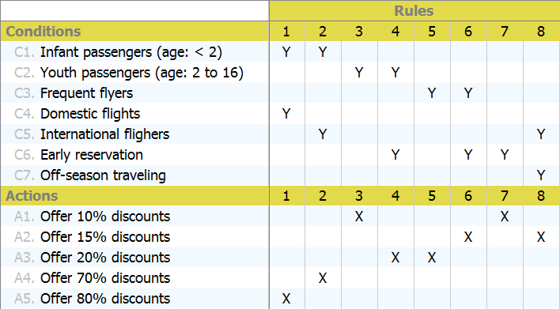
Now as a decision table…

Slide 233
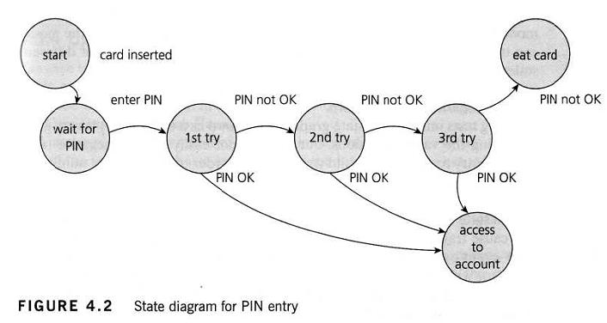
State Transition Testing
Convenient if you have a UML State Machine diagram handy…
…but seriously, you need to depict a finite state machine somehow
7 states
4 actions (transitions)

Slide 234
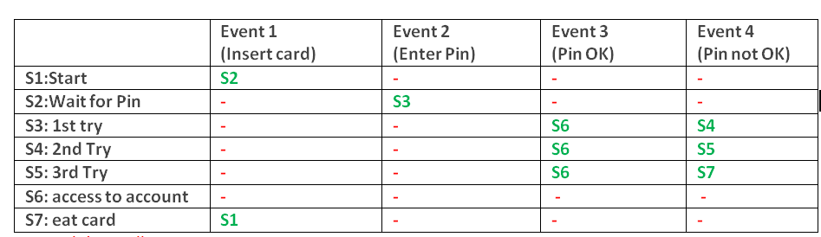
Transition table
Also need to test for invalid transitions
Sometimes difficult to spot on a state-transition table
Dashes represent invalid transitions

Slide 235
Use Case Testing
Convenient if your project requirements are documented as Use Cases
Part of UML
By convention, each use case describes:
The main success scenario
Alternative scenarios (or “extensions”)

Slide 236
Customer registration Use Case
Actors
Customer
Summary
A Customer who wants to use mobile hair care services registers to the site thereby creating an account.
Pre-Conditions
User not previously registered.
Basic course of action
Customer goes to the website and requests a new account
Customer enters enough of a profile to enable scheduling (name, address, email address, payment info, phone number)
Account is created.
Customer receives notification by email, text or both about the new account.
Alternative sequences
User abandons the registration process before account is created.
User cancels registration process.
Post-conditions
The account for the Customer exists.

Slide 237
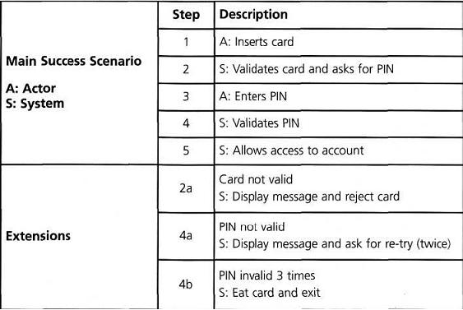
Example Use Case

Slide 238
ISIT 324 Software Testing
2020.03.04
Test Design Techniques continued

Slide 239
First things first…
Course evals are now open. Submit it, earn 5 points in the quizzes category.
HW 7 errata: the starting point decision table in problem 3 showed a bad condition in its first row. It has been corrected.
Error: a<=b+c?
Corrected: a<b+c?

Slide 240
On the Docket
Moq Homework Review
Specification-based test case design example (NextDate)
Structure-based testing
Experience-based testing
Intro to this week’s homework
Bonus delegates lecture???
*No group discussion assignment this week

Slide 241
About the final…
Final will be on Wednesday, 3/18 online. You can take it any time during the day (from 12:00am to 11:59pm) in a two-hour window.
I’ll set up a Zoom conference and will be available online from 3pm to 5:10pm.

Slide 242
Next Day Rules
Input: any valid date between 1/1/1818 and 12/31/2020
Output: the next calendar day
Special considerations:
Some months have 30 days
Some months have 31 days
February always has at least 28 days
On leap years, February has 29 days
Except for century years, every year evenly divisible by 4 is a leap year.
Every century year evenly divisible by 400 is a leap year.

Slide 243
Static
Dynamic
Informal
Reviews
Static Analysis
Data Flow
Walkthroughs
Control Flow
Technical Reviews
Inspections
Experience-based
Specification-based
Structure-based
Error Guessing
Equivalence Class Partitioning
Statement
Path
Exploratory testing
Boundary Value Analysis
Decision
LCSAJ
Decision tables
Condition
State Transition
Multiple Condition
Use case testing

Slide 244
Boundary Value Analysis (in our last episode)
Test at…well, the boundaries
Informal: For each range test min, max
Boundary value analysis is nearly always based on a single variable (single-fault assumption)

Slide 245
Some definitions
BVA ala ISTQB: min, max
Normal BVA: min, min+1, nominal, max, max-1
Robust BVA: min-1, min, min+1, nominal, max-1, max, max+1
Worst-case: multiple-variable faults. Test extreme values for each combination of variables. Requires the Cartesian product of all test values for each variable.
Robust worst-case: worst-case with errors. Yikes.
nominal value is in the approximate middle of the range*
* ISTQB does not require nominal values in BVA

Slide 246
Boundary Value Analysis Example
Partition a set of test conditions into groups or sets that are treated equivalently
PriceCalc (HW 3): five partitions
An example of one partition using robust BVA:
Invalid | Valid (reg price) |  | Valid (10% discount) |  | Valid (20% disc) |  | Invalid
0 | 1 | 9 | 10 | 19 | 20 | int.max | int.max+1
0, 1 , 2
min-1, min, min+1
5
nominal
8, 9, 10
max -1, max, max+1

Slide 247
BVA Example with NextDate
What are the Robust boundary values for:
Month?
Day?
Year?
Number of combinations of valid (i.e., non-Robust, worst case) test cases?
For the method (not each variable):
Untested functionality?
Redundancies

Slide 248
BVA Example with NextDate
What are the Robust boundary values for:
Month? 0, 1, 2, 6, 11, 12, 13
Day? 0, 1, 2, 15, 30, 31, 32
Year? 1817, 1818, 1819, 1918, 2019, 2020, 2021
Number of combinations of valid (i.e., non-Robust, worst case) test cases?
Number of Boundary Values^{Number of Input Variables} = 125
For the method (not each variable):
Untested functionality?
Redundancies

Slide 249
Selection of worst-case NextDate BVA test cases
Case | Month | Day | Year | Expected Output
1 | 1 | 1 | 1818 | 1,2,1818
2 | 2 | 1 | 1818 | 2,2,1818
3 | 6 | 1 | 1818 | 6,2,1818
4 | 11 | 1 | 1818 | 11,2,1818
5 | 12 | 1 | 1818 | 12,2,1818
6 | 1 | 2 | 1818 | 1,3,1818
7 | 2 | 2 | 1818 | 2,3,1818
8 | 6 | 2 | 1818 | 6,3,1818
9 | 11 | 2 | 1818 | 11,3,1818
10 | 12 | 2 | 1818 | 12,3,1818
11 | 1 | 15 | 1818 | 1,16,1818
12 | 2 | 15 | 1818 | 2,16,1818
…and so forth
Case | Month | Day | Year | Expected Output
-- | 6 | 31 | 1918 | Invalid
-- | 11 | 31 | 1928 | Invalid
125 | 12 | 31 | 2020 | 1,1,2021
…and so on…

Slide 250
Static
Dynamic
Informal
Reviews
Static Analysis
Data Flow
Walkthroughs
Control Flow
Technical Reviews
Inspections
Experience-based
Specification-based
Structure-based
Error Guessing
Equivalence Class Partitioning
Statement
Path
Exploratory testing
Boundary Value Analysis
Decision
LCSAJ
Decision tables
Condition
State Transition
Multiple Condition
Use case testing

Slide 251
Equivalence Partitioning (aka Equivalence Classes) -- Redux
Good technique to use first
Partition a set of test conditions into groups or sets that are treated equivalently
PriceCalc (HW 3): five equivalence classes (robust)
Invalid | Valid (reg price) |  | Valid (10% discount) |  | Valid (20% disc) |  | Invalid
0 | 1 | 9 | 10 | 19 | 20 | int.max | int.max+1
Any value
<1
Any value
1 <= x <=9
Any value
10 <= x <=19
Any value
20 <= x <=int.max
Any value that won’t fit

Slide 252
Definitions
Normal and Robust: same as for BVA, to wit:
Normal Equivalence Partitions consider only valid values
Robust Equivalence Partitioning adds test cases for invalid values
Weak: single variable
Strong: multiple variable
Normal/Robust and Weak/Strong can be combined.

Slide 253
EP Example with NextDate
Equivalence partitions: first, valid and invalid:
What’s a valid EP?
What are some invalid EPs?
Better equivalence partitions? Use domain knowledge!
What are the Weak Normal EPs?
What are some Strong Normal EPs?
What about…
Redundancy?
Untested functionality?

Slide 254
EP Example with NextDate
Equivalence partitions: first, valid and invalid Eps
What’s a valid EP? 6, 15, 1918 -> 6, 16, 1918
What are some invalid EPs? -1, 15, 1918; 13, 15, 1918; etc.
Better equivalence partitions? Use domain knowledge! (next slide)
What are the Weak Normal EPs?
What are some Strong Normal EPs?
What about…
Redundancy? Lots.
Untested functionality? Strong robust case: you get everything.

Slide 255
Equivalence Partitions for NextDate
New equivalence classes:
M1 – month has 30 days
M2 – month has 31 days
M3 – month is February
D1 – 1 <= day <= 28
D2 – day == 29
D3 – day == 30
D4 – day == 31
Y1 – year = 2000
Y2 – year is a non-century leap year
Y3 – year is a common year
Weak normal: just pick one example from each class. 4 combinations:
6, 14, 2000 (6/15/2000)
7, 29, 1996 (7/30/1996)
2, 30, 2002 (Invalid)
6, 31, 2000 (Invalid)
Strong normal: combine all classes for each variable. 36 combinations. Includes:
2/31/2002 (Invalid)
2/29/1996 (3/1/1996)
6/31/2002 (Invalid)
…

Slide 256
Static
Dynamic
Informal
Reviews
Static Analysis
Data Flow
Walkthroughs
Control Flow
Technical Reviews
Inspections
Experience-based
Specification-based
Structure-based
Error Guessing
Equivalence Class Partitioning
Statement
Path
Exploratory testing
Boundary Value Analysis
Decision
LCSAJ
Decision tables
Condition
State Transition
Multiple Condition
Use case testing

Slide 257
Decision Table Testing One More Time
EP and BVA are great, but…
Their strong/worst-case test cases yield redundancies over multiple interdependent variables
Decision table (aka “cause-effect table”) reflects intersection of business rules
 | TC 1 | TC 2 | TC 3
Condition 1 | T | F | F
Condition 2 | T | T | F
Condition 3 | F | T | F
Action 1 | X
Action 2 |  | X
Action 3 |  | X | X

Slide 258
Example Decision Table

Slide 259
NextDate Decision Table Equivalence Classes… after further consideration
M1 – month has 30 days
M2 – month has 31 days (except December)
M3 – month is December
M4 – month is February
D1 – 1 <= day <= 27
D2 – day == 28
D3 – day == 29
D4 – day == 30
D5 – day == 31
Y1 – year is a leap year
Y2 – year is a common year

Slide 260
NextDate Decision Table – Conditions and Actions
Conditions | 1 | 2 | …
Month in
Day In
Year In
Actions
Impossible
Increment day
Reset Day to 1
Increment month
Reset month
Increment year
M1 – month has 30 days
M2 – month has 31 days (except December)
M3 – month is December
M4 – month is February
D1 – 1 <= day <= 27
D2 – day == 28
D3 – day == 29
D4 – day == 30
D5 – day == 31
Y1 – year is a leap year
Y2 – year is a common year
M1
D1
-
X

Slide 261
NextDate Decision Table (Part 1)
Conditions | 1 | 2 | 3 | 4 | 5 | 6 | 7 | 8 | 9 | 10
Month in | M1 | M1 | M1 | M1 | M1 | M2 | M2 | M2 | M2 | M2
Day In | D1 | D2 | D3 | D4 | D5 | D1 | D2 | D3 | D4 | D5
Year In | - | - | - | - | - | - | - | - | - | -
Actions
Impossible |  |  |  |  | X
Increment day | X | X | X |  |  | X | X | X | X
Reset Day to 1 |  |  |  | X |  |  |  |  |  | X
Increment month |  |  |  | X |  |  |  |  |  | X
Reset month
Increment year
M1 – month has 30 days
M2 – month has 31 days (except December)
M3 – month is December
M4 – month is February
D1 – 1 <= day <= 27
D2 – day == 28
D3 – day == 29
D4 – day == 30
D5 – day == 31
Y1 – year is a leap year
Y2 – year is a common year

Slide 262
NextDate Decision Table (Part 2)
Conditions | 11 | 12 | 13 | 14 | 15 | 16 | 17 | 18 | 19 | 20 | 21 | 22
Month in | M3 | M3 | M3 | M3 | M3 | M4 | M4 | M4 | M4 | M4 | M4 | M4
Day In | D1 | D2 | D3 | D4 | D5 | D1 | D2 | D2 | D3 | D3 | D4 | D5
Year In | - | - | - | - | - | - | Y1 | Y2 | Y1 | Y2 | - | -
Actions
Impossible |  |  |  |  |  |  |  |  |  | X | X | X
Increment day | X | X | X | X |  | X | X
Reset Day to 1 |  |  |  |  | X |  |  | X | X
Increment month |  |  |  |  |  |  |  | X | X
Reset month |  |  |  |  | X
Increment year |  |  |  |  | X
M1 – month has 30 days
M2 – month has 31 days (except December)
M3 – month is December
M4 – month is February
D1 – 1 <= day <= 27
D2 – day == 28
D3 – day == 29
D4 – day == 30
D5 – day == 31
Y1 – year is a leap year
Y2 – year is a common year

Slide 263
NextDate Decision Table (Part 1 – reduction)
Conditions | 1 | 2 | 3 | 4 | 5 | 6 | 7 | 8 | 9 | 10
Month in | M1 | M1 | M1 | M1 | M1 | M2 | M2 | M2 | M2 | M2
Day In | D1 | D2 | D3 | D4 | D5 | D1 | D2 | D3 | D4 | D5
Year In | - | - | - | - | - | - | - | - | - | -
Actions
Impossible |  |  |  |  | X
Increment day | X | X | X |  |  | X | X | X | X
Reset Day to 1 |  |  |  | X |  |  |  |  |  | X
Increment month |  |  |  | X |  |  |  |  |  | X
Reset month
Increment year
M1 – month has 30 days
M2 – month has 31 days (except December)
M3 – month is December
M4 – month is February
D1 – 1 <= day <= 27
D2 – day == 28
D3 – day == 29
D4 – day == 30
D5 – day == 31
Y1 – year is a leap year
Y2 – year is a common year

Slide 264
NextDate Decision Table (Part 2) - reduction
Conditions | 11 | 12 | 13 | 14 | 15 | 16 | 17 | 18 | 19 | 20 | 21 | 22
Month in | M3 | M3 | M3 | M3 | M3 | M4 | M4 | M4 | M4 | M4 | M4 | M4
Day In | D1 | D2 | D3 | D4 | D5 | D1 | D2 | D2 | D3 | D3 | D4 | D5
Year In | - | - | - | - | - | - | Y1 | Y2 | Y1 | Y2 | - | -
Actions
Impossible |  |  |  |  |  |  |  |  |  | X | X | X
Increment day | X | X | X | X |  | X | X
Reset Day to 1 |  |  |  |  | X |  |  | X | X
Increment month |  |  |  |  |  |  |  | X | X
Reset month |  |  |  |  | X
Increment year |  |  |  |  | X
M1 – month has 30 days
M2 – month has 31 days (except December)
M3 – month is December
M4 – month is February
M5 – month < 1 || > 12
D1 – 1 <= day <= 27
D2 – day == 28
D3 – day == 29
D4 – day == 30
D5 – day == 31
D6 – day <1 || >31
Y1 – year is a leap year
Y2 – year is a common year
Y3 – year < 1818 || > 2018

Slide 265
Validate variables independently
Conditions | 1 | 2 | 3
Month in | M5 | - | -
Day In | - | D6 | -
Year In | - | - | Y3
Actions
Invalid | X | X | X
Valid
M1 – month has 30 days
M2 – month has 31 days (except December)
M3 – month is December
M4 – month is February
M5 – month < 1 || > 12
D1 – 1 <= day <= 27
D2 – day == 28
D3 – day == 29
D4 – day == 30
D5 – day == 31
D6 – day <1 || >31
Y1 – year is a leap year
Y2 – year is a common year
Y3 – year < 1818 || > 2018
But what happens if you want to include invalid data conditions in
the decision table?

Slide 266
Test Case == Unit Test?
No, but you need to ensure that all test cases are covered.
You can do loads of logical reduction based on intuition and knowledge of the domain, but you need to understand what you’re giving up
For NextDate()
Do we need BVA?
Do we need “valid/invalid” EP?
Do we need other domain-specific EPs?
Can we put out-of-range values in the decision table?
Can we reduce the decision table to produce test cases?

Slide 267
Unit Testing NextDate
Do we need BPA? No, not really. Not a “rangey” problem.
Do we need “valid/invalid” EP? Good for validation, so yes.
Do we need other domain-specific EPs? Yup. To support the decision tables.
Can we put out-of-range values in the decision table? Could. Add new conditions for each test case with “don’t cares” for the uninteresting elements
Can we reduce the decision table to produce test cases? Yes. Use the proposed reductions to combine the test cases.

Slide 268
Decision Table Test Cases for NextDate
Case ID | Month | Day | Year | Expected Output
1 - 3 | 4 | 15 | 2001 | 4/16/2001
4 | 4 | 30 | 2001 | 5/1/2001
5 | 4 | 31 | 2001 | Exception
6 – 9 | 1 | 15 | 2001 | 1/16/2001
10 | 1 | 31 | 2001 | 2/1/2001
11-14 | 12 | 15 | 2001 | 12/16/2001
15 | 12 | 31 | 2001 | 1/1/2002
16 | 2 | 15 | 2001 | 2/16/2001
17 | 2 | 28 | 2004 | 2/29/2004
18 | 2 | 28 | 2001 | 3/1/2001
19 | 2 | 29 | 2004 | 3/1/2004
20 | 2 | 29 | 2001 | Exception
21,22 | 2 | 30 | 2001 | Exception

Slide 269
Static
Dynamic
Informal
Reviews
Static Analysis
Data Flow
Walkthroughs
Control Flow
Technical Reviews
Inspections
Experience-based
Specification-based
Structure-based
Error Guessing
Equivalence Class Partitioning
Statement
Path
Exploratory testing
Boundary Value Analysis
Decision
LCSAJ
Decision tables
Condition
State Transition
Multiple Condition
Use case testing

Slide 270
Structure-Based Testing
Aka “white-box”
Requires zero domain knowledge
Goal: design test cases that maximize (code) coverage*
$Coverage=\frac{Number of coverage items exercised}{Total number of coverage items}$ $x 100\%$
*Also applies to business procedures

Slide 271
Dimensions of Coverage
Can be applied at any test level
Component, integration, system, acceptance…
Coverage items can include specification-based techniques
EPs exercised
BVA boundaries exercised
% of Decision Table business rules tested
States visited, transitions exercised, transition pairs, invalid transitions
And, of course, code is special a special kind of coverage item.
Easiest because of good tool support.
Coverage does NOT mean “what % of tests have been run”

Slide 272
How to Measure Coverage
Steps:
Decide on the structural element (i.e., coverage items to be counted)
Count all the structural elements or items
Instrument the code.
Run the tests for which coverage measurement is required.
Determine the percentage of elements exercised.
Code coverage tools do this automatically for the items they cover

Slide 273
Static
Dynamic
Informal
Reviews
Static Analysis
Data Flow
Walkthroughs
Control Flow
Technical Reviews
Inspections
Experience-based
Specification-based
Structure-based
Error Guessing
Equivalence Class Partitioning
Statement
Path
Exploratory testing
Boundary Value Analysis
Decision
LCSAJ
Decision tables
Condition
State Transition
Multiple Condition
Use case testing

Slide 274
Statement Coverage
$Coverage=\frac{Number of statements exercised}{Total number of statements}$ $x 100\%$
1 READ A
2 READ B
3 C = A + 2 * B
4 IF C > 50 THEN
PRINT ‘Large C’
6 ENDIF
Test 1.1: A = 1, B = 3 Statements covered?
Test 1.2: A = 0, B = 25 Statements covered?
Test 1.3: A = 47, B = 1 Statements covered?
Test 1.4: A = 20, B = 25 Statements covered?
How many tests required for 100% coverage?

Slide 275
Statement Coverage
$Coverage=\frac{Number of statements exercised}{Total number of statements}$ $x 100\%$
1 READ A
2 READ B
3 C = A + 2 * B
4 IF C > 50 THEN
PRINT ‘Large C’
6 ENDIF
Test 1.1: A = 1, B = 3 Statements covered? 1,2,3,4,6
Test 1.2: A = 0, B = 25 Statements covered? 1,2,3,4,6
Test 1.3: A = 47, B = 1 Statements covered? 1,2,3,4,6
Test 1.4: A = 20, B = 25 Statements covered? 1,2,3,4,5,6
How many tests required for 100% coverage? 1

Slide 276
Static
Dynamic
Informal
Reviews
Static Analysis
Data Flow
Walkthroughs
Control Flow
Technical Reviews
Inspections
Experience-based
Specification-based
Structure-based
Error Guessing
Equivalence Class Partitioning
Statement
Path
Exploratory testing
Boundary Value Analysis
Decision
LCSAJ
Decision tables
Condition
State Transition
Multiple Condition
Use case testing

Slide 277
Decision Coverage
$Coverage=\frac{Number of decision outcomes exercised}{Total number of decision outcomes}$ $x 100\%$
…where decision outcome is the result of an if, a loop, or a case statement.
1 READ A
2 READ B
3 C = A + 2 * B
4 IF C > 50 THEN
PRINT ‘Large C’
6 ENDIF
Test 1.4: A = 20, B = 25 Statements covered? 100%

Slide 278
Decision Coverage
Read
1 READ A
2 READ B
3 C = A + 2 * B
4 IF C > 50 THEN
PRINT ‘Large C’
6 ENDIF
Test 1.1: A = 20, B = 25
Statement coverage: 100%
Decision coverage: ?
C = A+2*B
C > 50
Print
EndIf

Slide 279
Decision Coverage
Read
1 READ A
2 READ B
3 C = A + 2 * B
4 IF C > 50 THEN
PRINT ‘Large C’
6 ENDIF
Test 1.1: A = 20, B = 25
Statement coverage: 100%
Decision coverage: 50%
C = A+2*B
C > 50
Print
EndIf

Slide 280
Decision Coverage
Read
1 READ A
2 READ B
3 C = A + 2 * B
4 IF C > 50 THEN
PRINT ‘Large C’
6 ENDIF
Test 1.1: A = 20, B = 25
Test 1.2: A = 20, B = 10
For Test Set:
Statement coverage: 100%
Decision coverage: 100%
C = A+2*B
C > 50
Print
EndIf
100% Decision Coverage results in 100% Statement Coverage
100% Statement Coverage does not result in 100% Decision Coverage

Slide 281
Static
Dynamic
Informal
Reviews
Static Analysis
Data Flow
Walkthroughs
Control Flow
Technical Reviews
Inspections
Experience-based
Specification-based
Structure-based
Error Guessing
Equivalence Class Partitioning
Statement
Path
Exploratory testing
Boundary Value Analysis
Decision
LCSAJ
Decision tables
Condition
State Transition
Multiple Condition
Use case testing

Slide 282
Other Structure-Based Techniques
Condition Coverage reports true and false outcome of each condition
Example: if((A||B) && C) Requires 3 tests (number of conditions):
A == true / B == not evaluated / C == false
A == false / B == true / C == true
A == false / B == false / C == not evaluated
Multiple Condition Coverage all possible combinations of outcomes
Complete decision table
Example: above expression requires 8 tests (2 ^{number of conditions} )*
*With no short circuits

Slide 283
Code Coverage Exploration – Back to NextDate()
Use “Analyze Code Coverage” to run tests.
Run only NextDate_Should tests.
Yellow coloring means the compound condition was partly executed
What if we broke up the compound condition in Leap Year?
You can determine precisely which condition is not executing
Happily, we have Leap Year tests to round off the rough spots.

Slide 284
Static
Dynamic
Informal
Reviews
Static Analysis
Data Flow
Walkthroughs
Control Flow
Technical Reviews
Inspections
Experience-based
Specification-based
Structure-based
Error Guessing
Equivalence Class Partitioning
Statement
Path
Exploratory testing
Boundary Value Analysis
Decision
LCSAJ
Decision tables
Condition
State Transition
Multiple Condition
Use case testing

Slide 285
Experience-Based Testing
Error guessing and fault attack
Directed attempt to evaluate the quality, especially reliability, of a test object by attempting to force specific errors to occur
Used as a complement to formal techniques
No rules.
“That could never happen…”
Based on tester experience
Can have a plan
Exploratory testing
Informal technique where tester actively controls the design of tests as those tests are performed and uses information gained while testing to design new and better tests.
Checking boundaries based on domain knowledge, no formalism

Slide 286
How to choose a technique?
Internal factors
Models available (state machine, use cases, etc.)
Tester knowledge/experience
Knowledge of likely defects
Test objective
Documentation available
Life cycle model
External factors
Risk
Contractual requirements
Regulatory requirements
Type of system (Computation intensive? Logic intensive?)
Time and Budget

Slide 287
Delegates – the bare bones
Normally when you pass a parameter to a method, you’re sending a variable (either by value or by reference)
A C# delegate enables you to pass a reference to a method. It’s similar to a C++ function pointer but is object-oriented and type safe.
Java doesn’t support delegates, per se, but you can simulate them using interfaces.
Delegates are used for two primary purposes
Implementing events
Implementing callbacks

Slide 288
Declaring and using a named delegate
Declare the delegate.
public delegate void Del(string message);
Create a method for it.
public static void DelegateMethod(string message)
{
Console.WriteLine(message);
}
Instantiate the delegate
Del handler = DelegateMethod;
Call the delegate
handler("Hello World");

Slide 289
Delegates and Lambdas
In this demo:
Standard delegate
Delegate with an anonymous method
Using a lambda

Slide 290
Callback
Note that the preceding demo demonstrates callbacks.
In computer programming, a callback…is any executable code that is passed as an argument to other code that is expected to call back (execute) the argument at a given time. This execution may be immediate as in a synchronous callback, or it might happen at a later time as in an asynchronous callback. Programming languages support callbacks in different ways, often implementing them with subroutines, lambda expressions, blocks, or function pointers.
- Wikipedia

Slide 291
Multicast Delegate

Slide 292
Advanced topic: Built-in delegate types
Action: generic delegate type for a delegate that returns void
Func: generic delegate type for delegates that return values

Slide 293
ISIT 324 Software Testing
2020.03.11
UI Testing using Selenium

Slide 294
First things first
Don’t forget your course evaluation!
Student success day survey

Slide 295
On the Docket
What’s on the Final?
About redundant code in HW 6 (Moqs)…
Homework 7 review
UI Testing for Web Apps with Selenium
Optional homework assignment

Slide 296
What’s on the Final?
General questions from weeks 1 – 6, 9 and 10
In-depth questions from test design including:
Identifying equivalence classes
Building a decision table
Write a unit test using DataRows against an SUT provided for you
What’s NOT on the final?
Test doubles
Web automation

Slide 297
Web Automation
Scraping
Testing

Slide 298
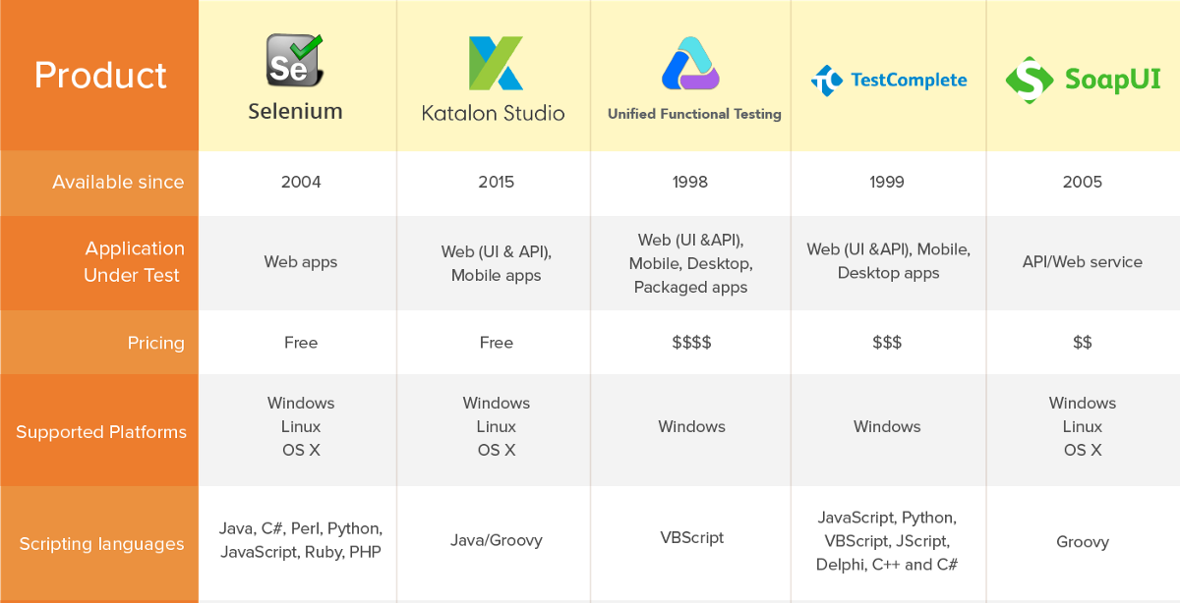

Slide 299
Disclaimer and Recommendation
Disclaimer: Full disclosure
Your intrepid instructor does not have deep front-end web development experience
Nor is your intrepid instructor a Selenium expert
Recommendation: Follow the in-class ride-along carefully
Your optional homework involves building on the example we craft in class. If you don’t have it in hand, you’ll have to start from the beginning.

Slide 300
The Plan
Note: We’ll use Chrome to display the site and Chrome-specific libraries to automate
Drive interaction with the Bellevue College website

Slide 301
Ride-along: Puppet Master of Bellevue College
Navigate and report info about which pages are visited
Open the BC home page
Click on the Classes link
Select Winter Quarter 2020
Search for “ISIT 324”
Click on search result and go to ISIT 324 detail page
Navigate to Final Exam schedule
Take a screen shot and save it
Hit the Back button

Slide 302
Setting up
Note: We’ll use Chrome to display the site and Chrome-specific libraries to automate
Build a console app
Add these NuGet Packages
Selenium.WebDriver: Use “Latest stable”, not “latest prerelease”
Selenium.Chrome.WebDriver (NOT Selenium.WebDriver.ChromeDriver)
Selenium.Support: Use “Latest stable”, not “latest prerelease”
Add using statements for the newly-added assemblies
using OpenQA.Selenium;
using OpenQA.Selenium.Chrome;
using OpenQA.Selenium.Support.UI;

Slide 303
The general shape of things
The web driver itself is an instance of IWebDriver with a Chrome-specific implementation:
IWebDriver driver = new ChromeDriver();
Ask the driver to get to the page you want to start driving from with its Navigate() method:
driver.Navigate().GoToUrl("https://www.bellevuecollege.edu/");
Close down at the end of the session
driver.Quit();

Slide 304
The general shape of things
Locate stuff on the page by using its FindElement() method:
IWebElement ele = aDriver.FindElement(By.Id("title"));
…or class name or CSS selector or Xpath or…
Lots of actions/properties: Text, Click(), SendText(), etc.
How to find an element? In Chrome use Inspect:
In the browser, right-click the element you want to be able to find
Select Inspect from the context menu
The tag for the element is (usually) highlighted
For the CSS selector, right click the element and copy it: on the context menu Copy/Copy selector

Slide 305
Ride-along: Puppet Master of Bellevue College
Navigate and report info about which pages are visited
Open the BC home page
Click on the Classes link
Select Winter Quarter 2020
Search for “ISIT 324”
Click on search result and go to ISIT 324 detail page
Navigate to Final Exam schedule
Take a screen shot and save it
Hit the Back button

Slide 306
Artist’s Conception
Home page
Page 1
Page 2
HTML
HomePage
Page1
Page2
Classes
Test1
Test2
Test3
Test4
Unit Tests

Slide 307
Shape of a Page Object Model
Set up a static Driver class
One class per page
Properties: One private property per element you want to access
Methods:
Get method for every element you need to access
Action method for any Selenium methods you need to call
Some developers like to split out:
Page definitions (properties only)
Navigation
Actions
Note: Many online resources use the PageFactory class. It’s been deprecated. Try not to use it.

Slide 308
Ride-along: Objectify the earlier Ride-Along
First as a Console App
Navigate and report info about which pages are visited
Open the BC home page
Click on the Classes link
Select Winter Quarter 2019
Search for “ISIT 324”
Click on search result and go to ISIT 324 detail page
Navigate to Final Exam schedule
Take a screen shot and save it
Hit the Back button

Slide 309
Ride-along: Add Some Unit Tests
Use FluentAssertions. Good at handling objects.
Tests we’ll add:
Click on Classes, make sure you end up there
Click on Programs, make sure you end up there
Click on Classes, go back, click on Programs, go back, and make sure you visited both pages
Search from common search box, make sure you get the correct result

